Slide 1
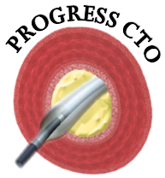

PROspective Global REgiStry for the Study of CTO interventions
NCT02061436
Registry update: April 2024
Emmanouil S. Brilakis, MD, PhD
Minneapolis Heart Institute & Foundation

Slide 2
A. Enrollment

Slide 3
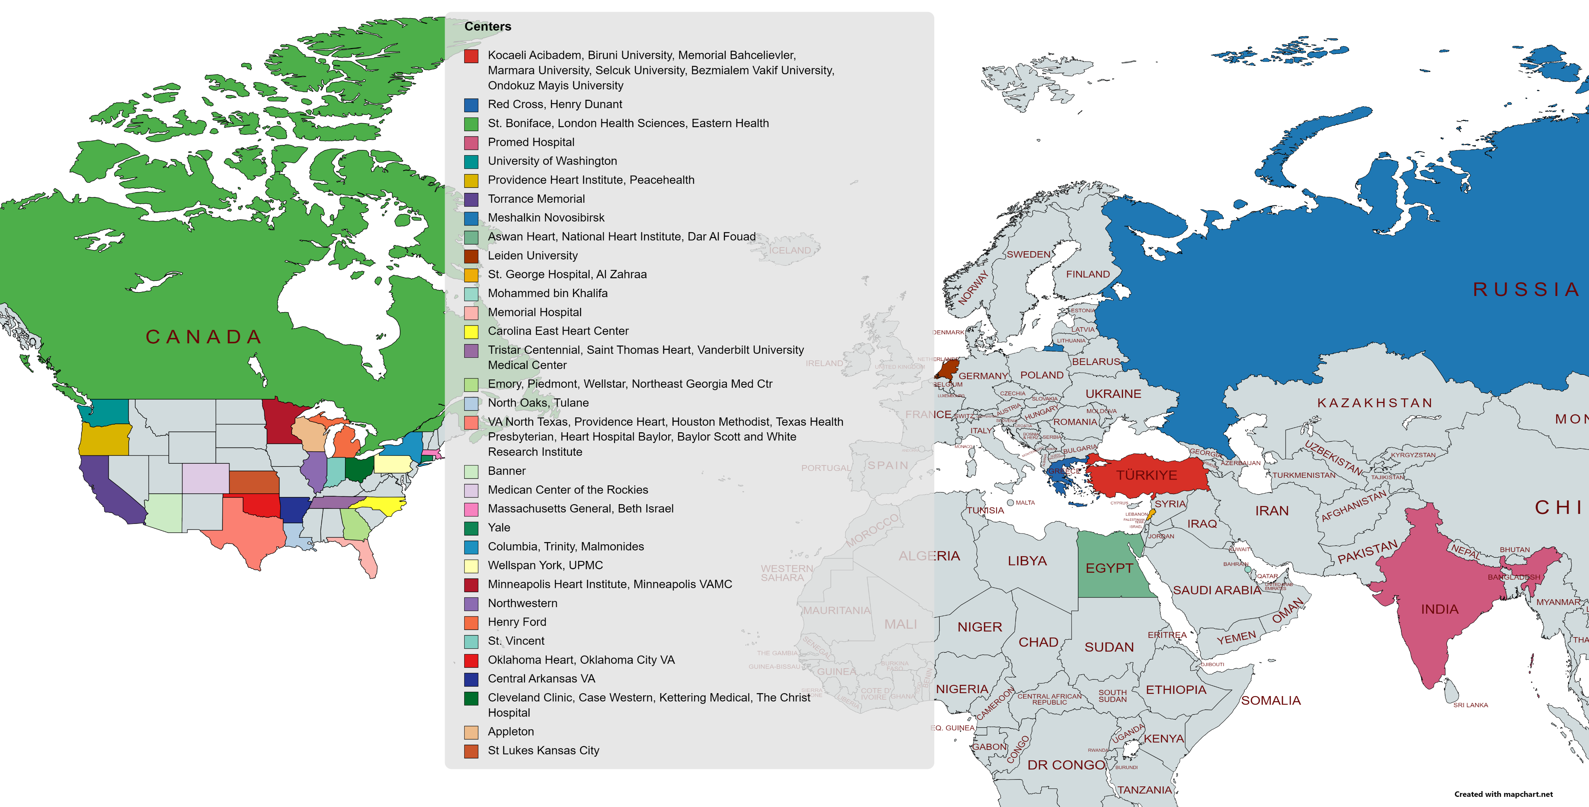
Global Coordinating Center: Chairman/PI: E. S. Brilakis; Global Director: B.V. Rangan;
Database Managers: Athanasios Rempakos, Michaella Alexandrou, Deniz Mutlu, Dimitrios Strepkos, Pedro Carvalho
Operational Support: Olga Mastrodemos
Project Impact: Data from 16,078 cases at 69 participating centers, 10 countries
Resulting in 134 publications, 197 conference presentations
NCT02061436

Slide 4
PROGRESS-CTO Registry
Total: 16,078 (as of 04/24/2024)
2023: 1,703
2022: 2,383
2021: 1,737
2020: 1,586

Slide 5
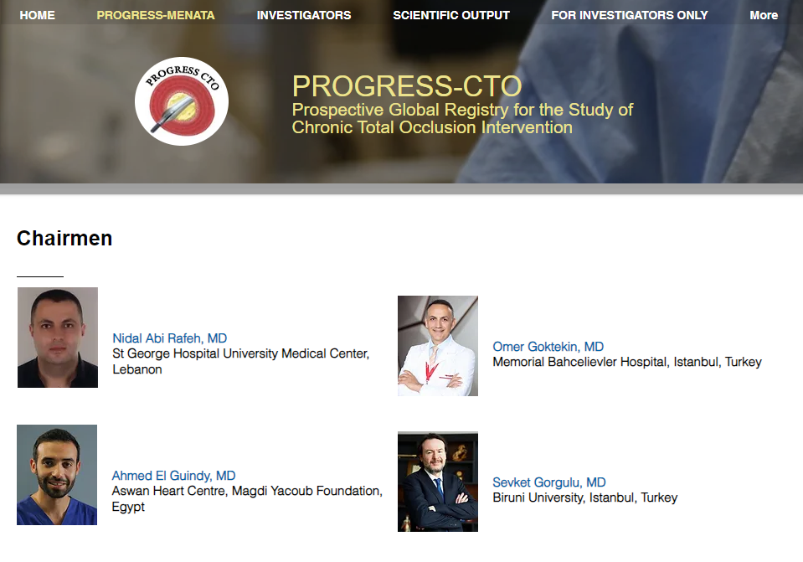
PROGRESS-CTO Registry
PROGRESS MENATA Chapter: 1,846 cases (as of 04/24/2024)

Slide 6
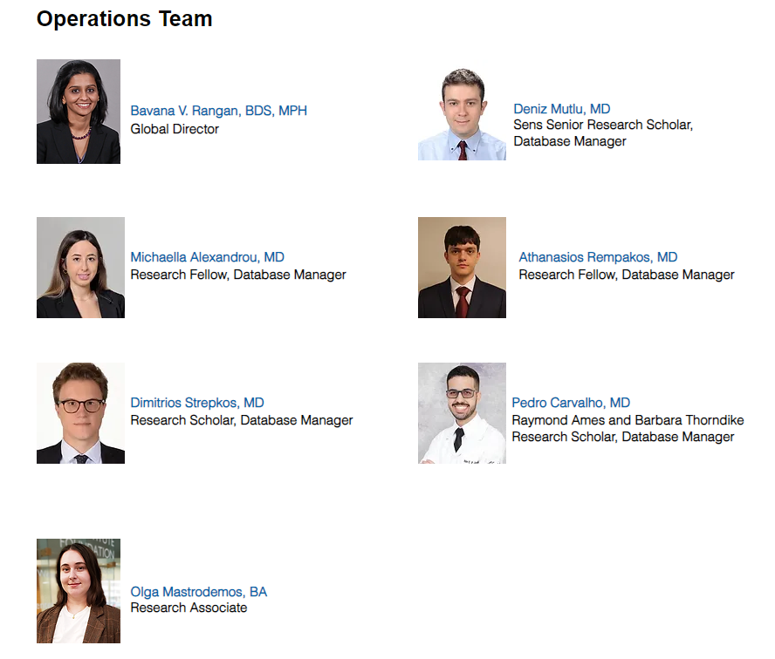
MHIF Coordinating Center

Slide 7
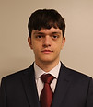
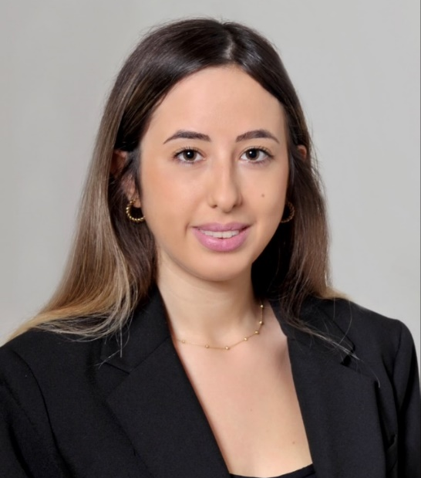
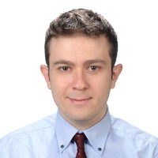
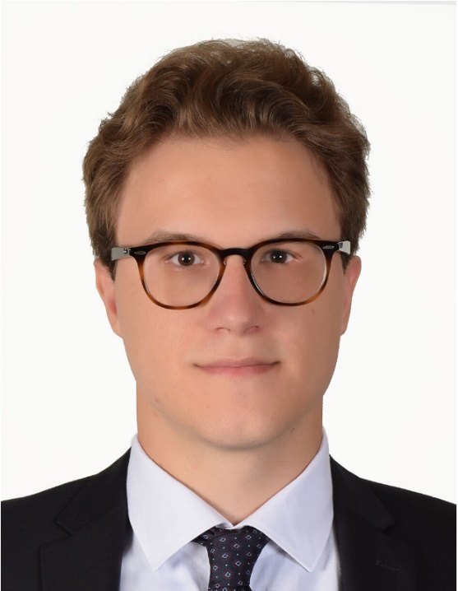
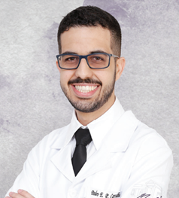
2023-2026 CCAD Scholars
2024 Graduating CCAD Scholar
Athanasios Rempakos, MD
Research Scholar/ Fellow
National and Kapodistrian University
of Athens, Greece
July 2024 starting IM Residency, Beaumont Royal Oak Hospital, Michigan
Michaella Alexandrou, MD
Research Scholar/Fellow
National and Kapodistrian University
of Athens, Greece
Deniz Mutlu, MD
Sens Sr. Research Scholar/Fellow
Cardiologist with training from: Istanbul University-Cerrahpasa and Acibadem University, Turkey
Dimitrios Stepkos, MD
Research Scholar/Fellow
National and Kapodistrian University
of Athens, Greece
Pedro Carvalho, MD
Barbara Thorndike and Raymond Ames Research Scholar/Fellow
Federal University of Minas Gerais, Brazil

Slide 8

Top 5 enrollers (overall):
Henry Ford (US) (Dr. Alaswad) (1706)
Novosibirsk Research (Russia) (Drs. Khelimskii, Krestyaninov) (1246)
Biruni University & Kocaeli Acibadem (Turkey) (Dr. Gorgulu) (1019)
Cleveland Clinic (US) (Dr. Khatri, Dr. Young) (846)
Massachusetts General (US) (Drs. Doshi, Jaffer) (732)
Top 5 enrollers (MENATA):
Kocaeli Acibadem & Biruni University (Turkey) (Dr. Gorgulu) (1019)
Aswan Heart Center (Egypt) (Dr. ElGuindy) (265)
Selcuk University (Turkey) (Dr. Avgul) (265)
Marmara University (Turkey) (Dr. Tigen) (95)
5. Ondokuz Mayis University (Turkey) (Drs. Soylu, Yildirim) (74)
Top 5 enrollers (2024):
Biruni University & Kocaeli Acibadem Hospital (Turkey) (Dr. Gorgulu) (118)
Henry Ford (US) (Dr. Alaswad) (83)
Benzmialem Vakif University (Turkey) (Dr. Ozdemir, Dr. Uluganyan) (38)
Minneapolis Heart Institute (US) (Dr. Brilakis) (37)
Cleveland Clinic (US) (Dr. Khatri, Dr. Young) (30)
Top 5 enrollers (2023):
Biruni University & Kocaeli Acibadem Hospital (Turkey) (Dr. Gorgulu) (316)
Henry Ford (US) (Dr. Alaswad) (244)
WellSpan York Hospital (US) (Dr. Davies) (173)
Novosibirsk Research (Russia) (Drs. Khelimskii, Krestyaninov) (159)
Cleveland Clinic (USA) (Dr. Khatri, Dr. Young) (129)

Slide 9
B. PUBLICATIONS

Slide 10
Published manuscripts
Application and outcomes of the hybrid approach
Comparison with other studies
Target vessel and outcomes
Mode of failure
Prior CABG
Radial approach
J-CTO score validation
PROGRESS-CTO score
In-stent restenosis
Impact of prior failed CTO PCI
Side-branch loss
Antegrade dissection/re-entry outcomes
Guidewire utilization in AWE
Contrast utilization
Proximal cap ambiguity
Retrograde outcomes
Impact of lesion age
Use of SVGs for retrograde approach
Use of intravascular imaging
Balloon uncrossable occlusions
CTO scores comparative analysis
PROGRESS-CTO Complications score
Impact of age and sex
Impact of diabetes
Approaches to RCA occlusions
Spatial distribution of CTOs
Radiation exposure
Further validation of hybrid algorithm
Effect of proximal vessel tortuosity
Effect of calcification
Perforation incidence treatment and outcomes
Hybrid Approach for CTO-PCI – Update
CTO PCI in patients with CKD
Ostial CTO PCI
Use of guide catheter extension in Rcart
Retrograde CTO PCI via LIMA
Balloon undilatable CTOs
Mechanical cardiac support
Left main CTO PCI: a case series
Use of the DyeVert System in Chronic Total Occlusion Percutaneous Coronary intervention
>1 CTO PCI during the same procedure
CTO PCI via radial approach
PAD
Retrograde via SVG
Subintimal plaque modification
Impact of IVUS for stent optimization on outcomes
Impact of Concomitant Treatment of Non-Chronic Total Occlusion Lesions at the Time of Chronic Total Occlusion Intervention
Ad hoc vs planned CTO PCI
Usefulness of atherectomy in CTO Interventions
In-hospital outcomes of CTO PCI interventions in patients with prior CABG
Impact of technical success on outcomes
Impact of prior CABG on follow-up outcomes
Temporal trends
Comparison of scores
Distal radial
In-stent restenosis
Patient radiation dose
Equipment utilization
CT co-registration
Adherence to hybrid algorithm
Viability according to history of MI
Outcomes of CTO-PCI in patients with MI
Laser for balloon uncrossable and undilatable chronic total occlusion interventions
In-stent CTO PCI: Pooled Analysis of 4 multicenter registries
CTO PCI in octogenarians and nonagenarians
Chronic total occlusion percutaneous coronary intervention during the COVID-19 pandemic
Outcomes of Chronic Total Occlusion CTO PCI According to Race
Impact of adherence to the hybrid algorithm for initial crossing strategy selection in CTO PCI
PCI of CTOs Involving a Bifurcation
Outcomes of CTO PCI in patients with reduced LVEF
Association of Annual Operator Volume with Outcomes of Chronic Total Occlusion Percutaneous Coronary Intervention
Primary versus Secondary Retrograde in CTO interventions
Temporal Trends in Retrograde Crossing of Epicardial Collaterals in CTO PCI
Balloon undilatable CTO lesions
BMI in CTO PCI
Perforation in CTO PCI
Intravascular lithotripsy in CTO PCI
ADR vs. parallel wiring in CTO PCI
Radial access in CTO PCI
PROGRESS-CTO complication scores
Predictors of success in primary retrograde strategy in CTO PCI
Assessment of the OPEN-CLEAN perforation score
PROGRESS CTO overall update
PROGRESS-CTO perforation score
Preprocedural CCTA in CTO PCI
LAST in CTO PCI
ACS vs no ACS in CTO PCI
SVG occlusion in CTO PCI
Gender differences in CTO PCI
MCS in CTO PCI
Equipment utilization in CTO PCI
Bivalirudin in CTO PCI
Single vs multiple operator in CTO PCI
IVUS in CTO PCI
Prior failed attempt in CTO PCI
Impact of lesion length in CTO PCI
Impact of proximal cap ambiguity in CTO PCI
Balloon uncrossable lesions in CTO PCI
Same-day discharge in CTO PCI
Ad hoc CTO PCI
ERCTO score in predicting success in retrograde
Procedure time and CTO PCI outcomes
Ostial lesions in CTO PCI
Quality of distal vessel in CTO PCI
Aortacoronary dissection in CTO PCI
Atrial fibrillation in CTO PCI
CTO PCI in prior CABG patients
Impact of calcium in CTO PCI
Anemia in CTO PCI
Frequency of tip in
Adverse events with coronary IVL use
Activated Clotting Time and CTO PCI outcomes
BASE and CTO PCI
Carlino and CTO PCI
PROGRESS-CTO MENATA
Calcium modification strategies in dissection and re-entry vs wiring techniques in CTO PCI
EES vs ZES in CTO PCI
ADR in CTO PCI
Frequency of tip in
The retrograde approach to CTO PCI
Interventional collaterals in CTO PCI
CHIP score validation in CTO PCI
Global geographical diversity in CTO PCI
Polymer-jacketed wires in CTO PCI
Emergency CABG in CTO PCI
Equipment loss/entrapment in CTO PCI
Predictors of success in AWE in CTO PCI
Machine learning predicting AWE crossing success in CTO PCI
Race in CTO PCI
Ipsilateral collaterals in CTO PCI
Radiation trends in CTO PCI
Iso-osmolar vs low-osmolar contrast agents for coronary OCT
Use of plaque modification microcatheters during CTO PCI
Validation of J-Channel Score for Retrograde Channel Crossing

Slide 11
C. FUTURE DIRECTIONS

Slide 12
Ongoing projects
Atherectomy in CTO PCI – Manuscript in preparation
Anomalous coronaries in CTO PCI – Manuscript in preparation
Peripheral artery disease in CTO PCI – Manuscript in preparation
Guide extension in CTO PCI – Manuscript in preparation
Operator experience in retrograde wiring – Manuscript in preparation
Snaring in CTO PCI – Manuscript in preparation
New JCTO score validation – Manuscript under review
Retrograde success score – Manuscript in preparation
Guide size in CTO PCI – Manuscript in preparation
STAR in CTO PCI – Manuscript in preparation
Machine learning CTO success score – Manuscript in preparation
Proximal vessel tortuosity in CTO PCI – Manuscript in preparation

Slide 13
D. RECENT PUBLICATIONS

Slide 14
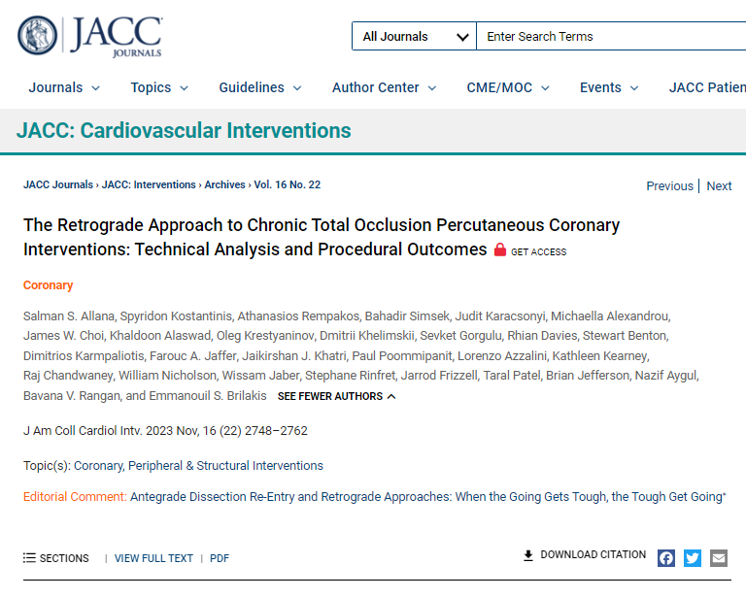
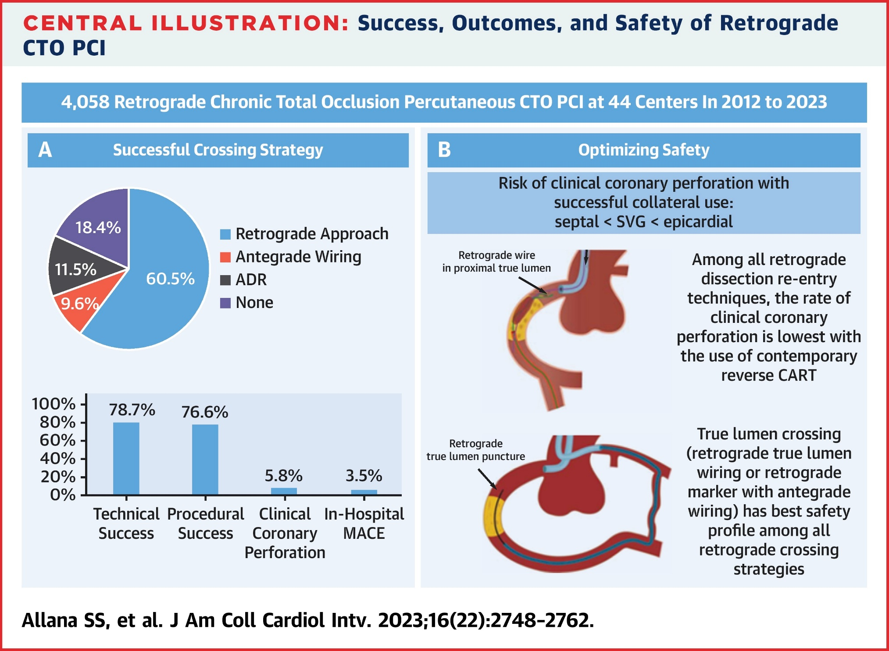
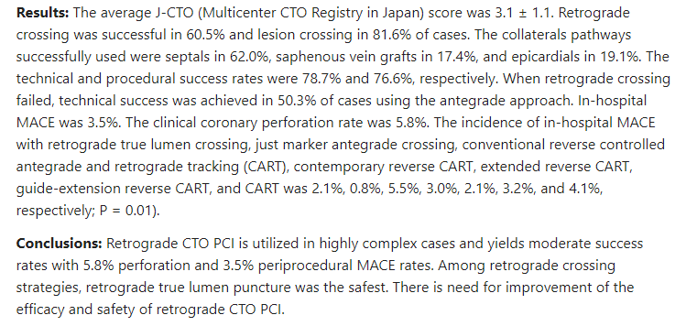

Slide 15
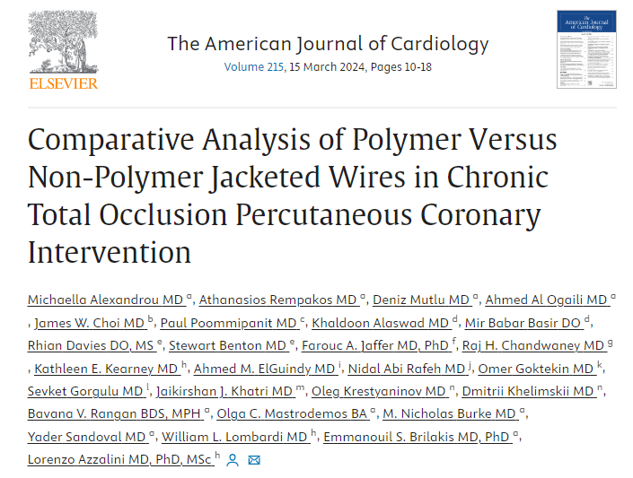
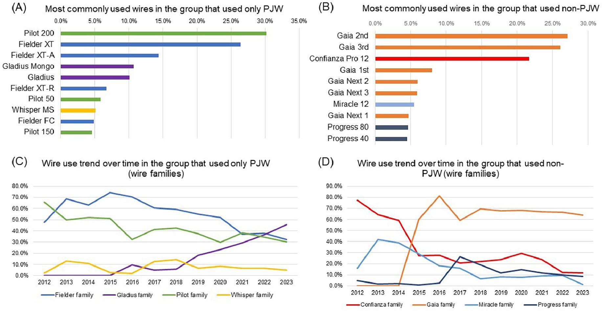
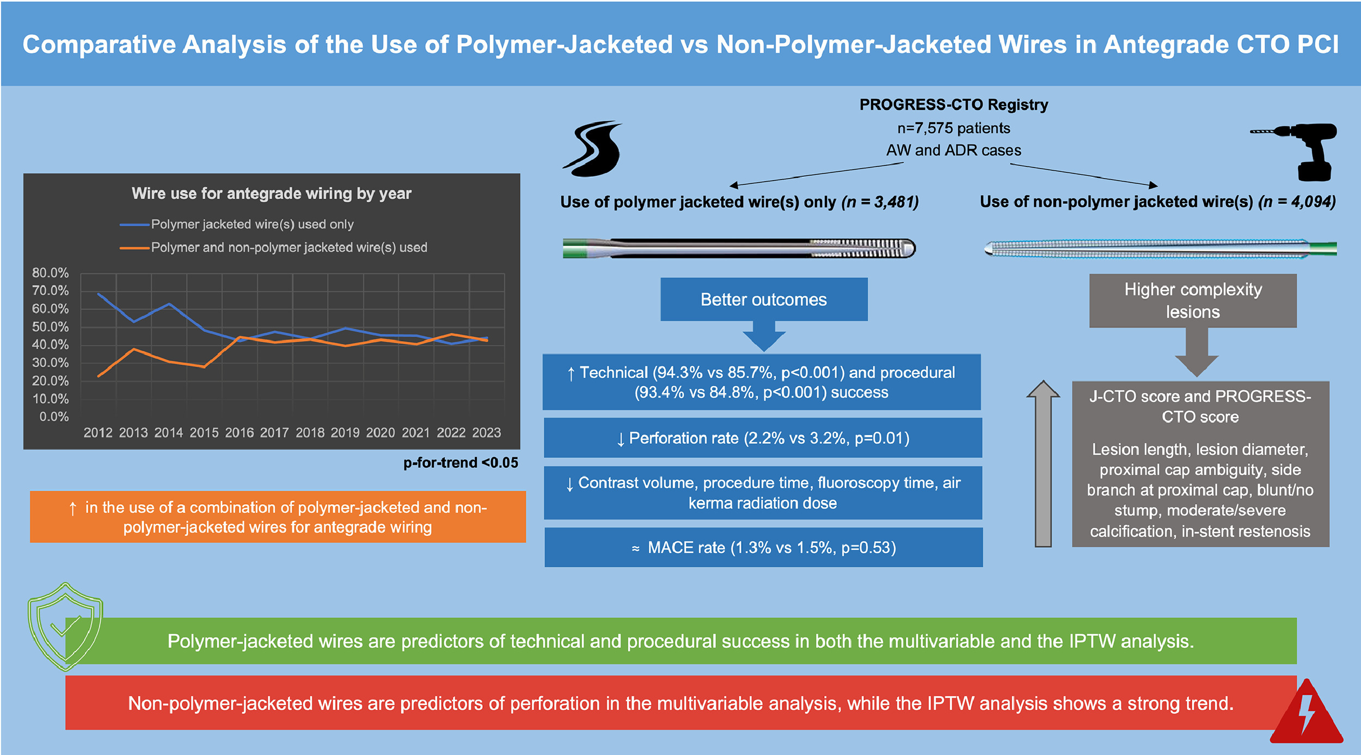
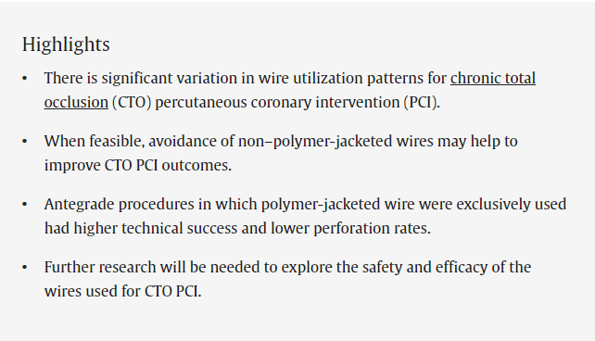

Slide 16
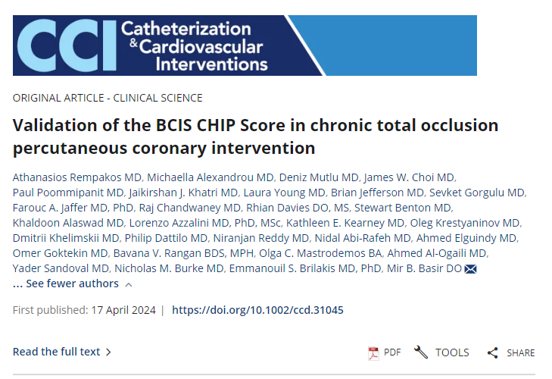
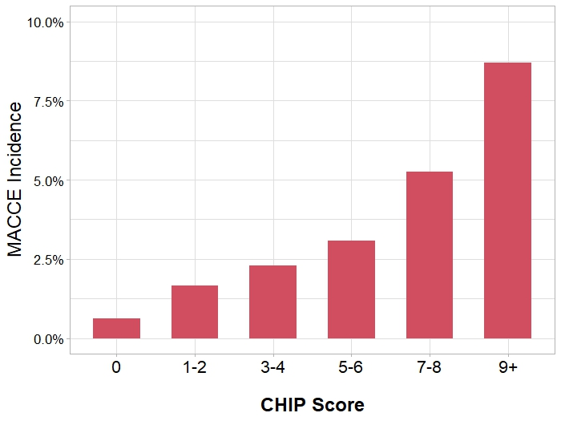
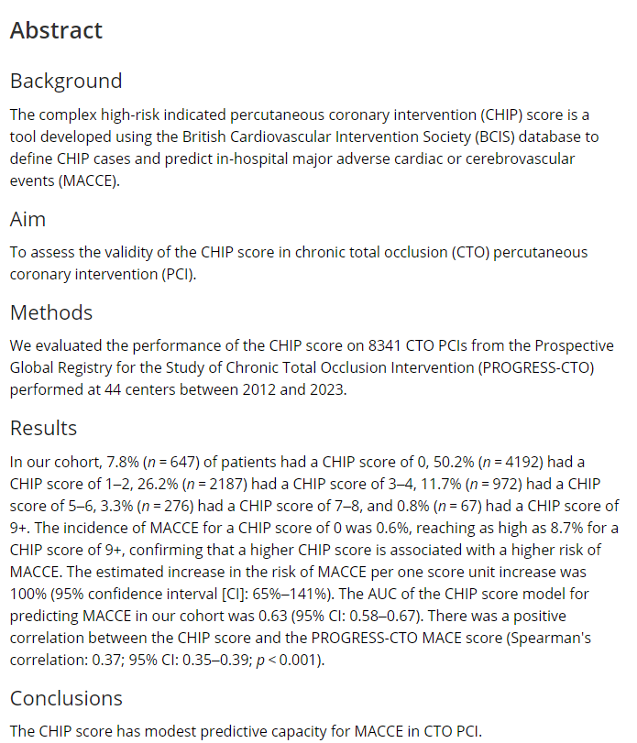
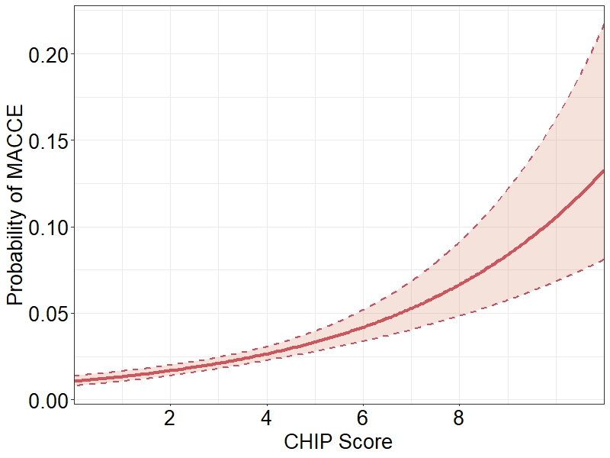
Figure 1: Incidence of MACCE for each value of the CHIP score.
Figure 2: Probability of MACCE stratified by CHIP score.

Slide 17
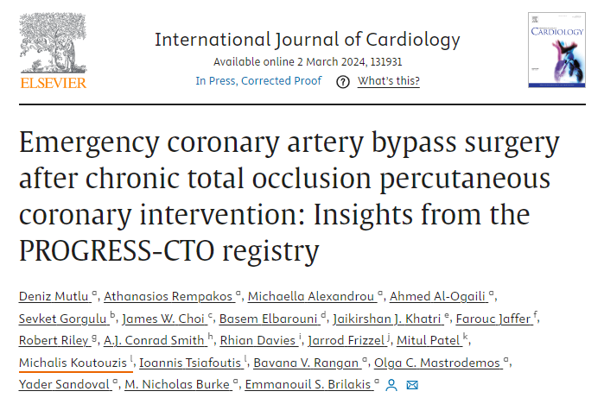
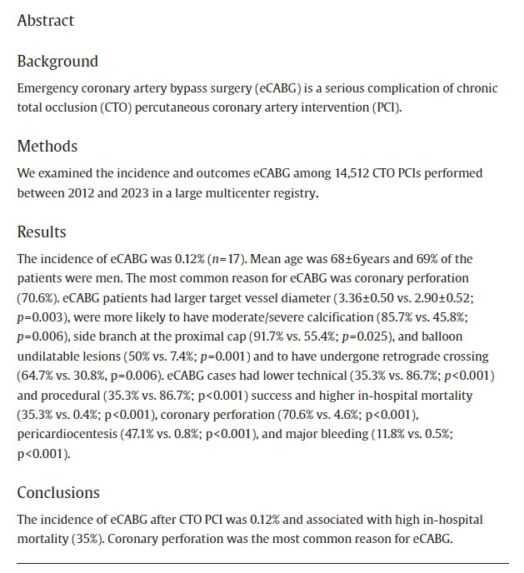
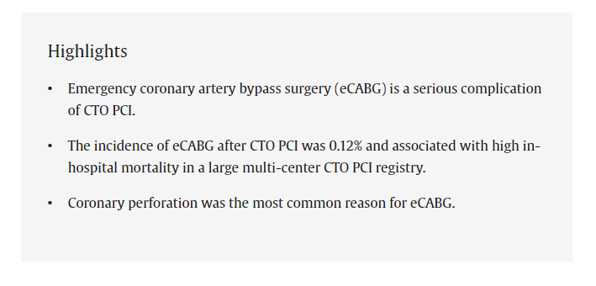

Slide 18
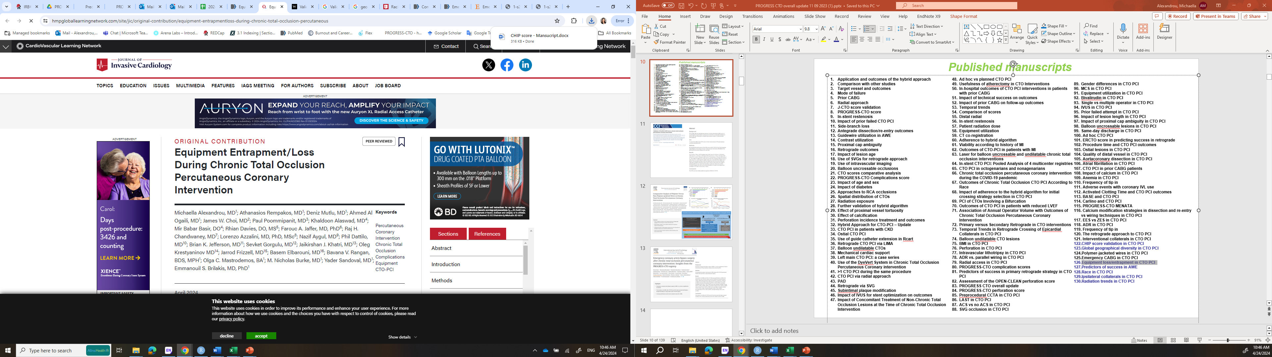
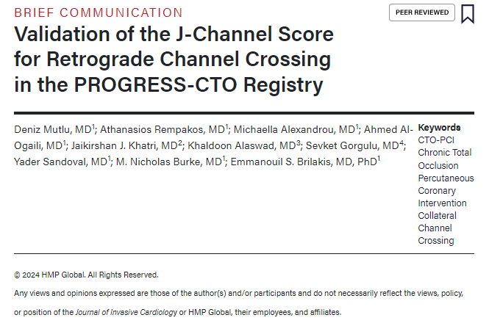
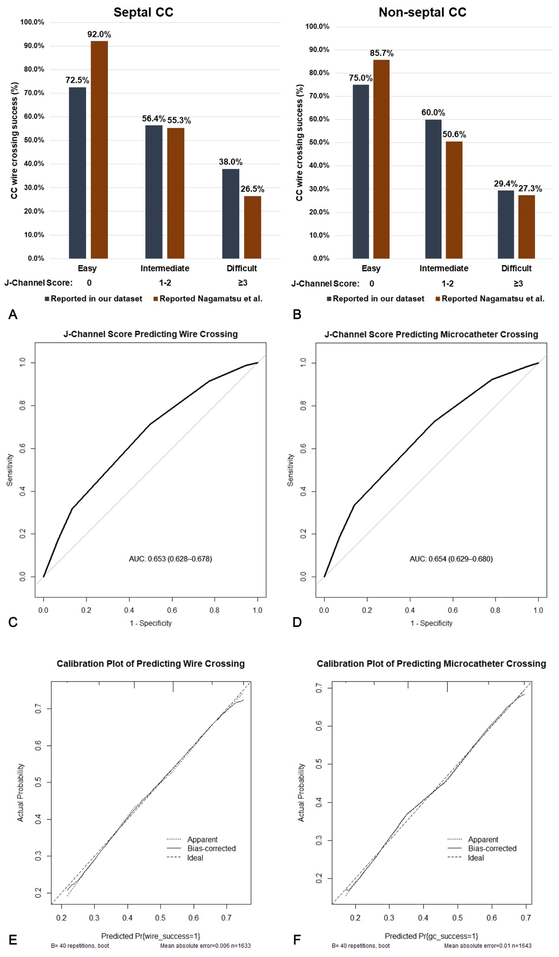
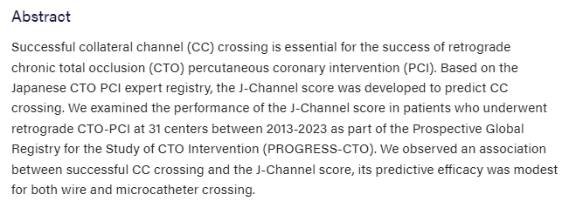

Slide 19
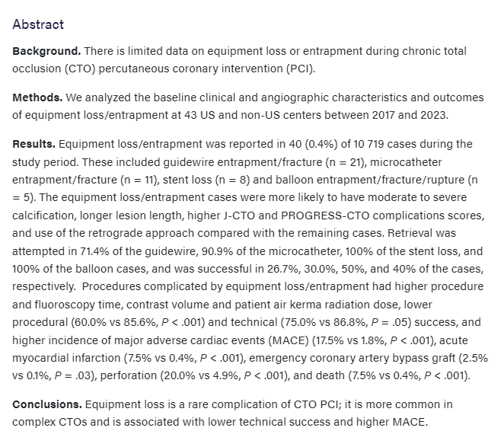
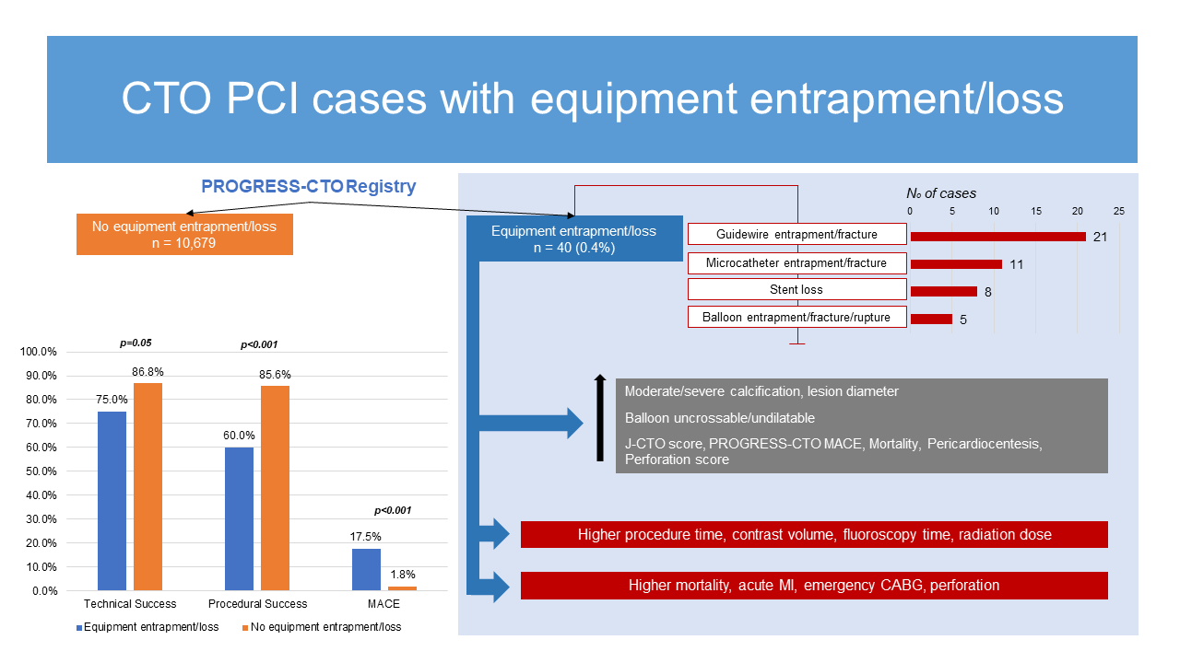

Slide 20
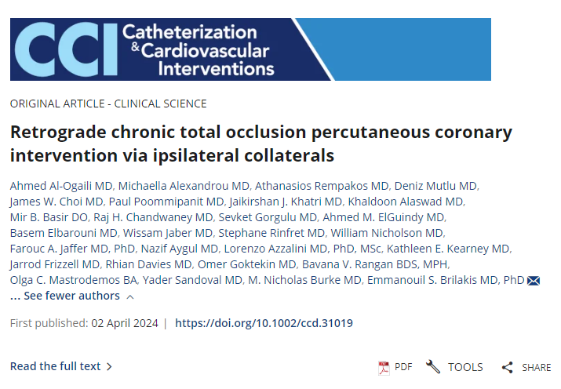
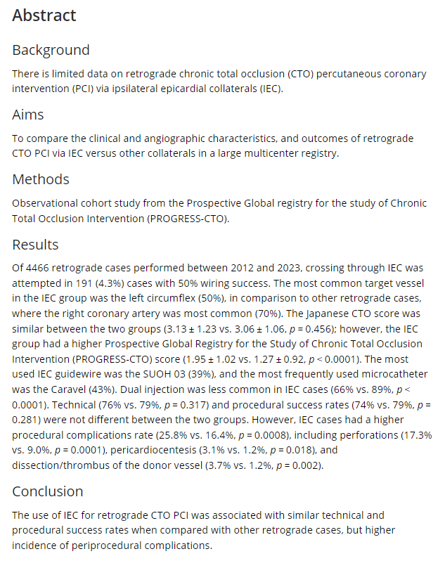
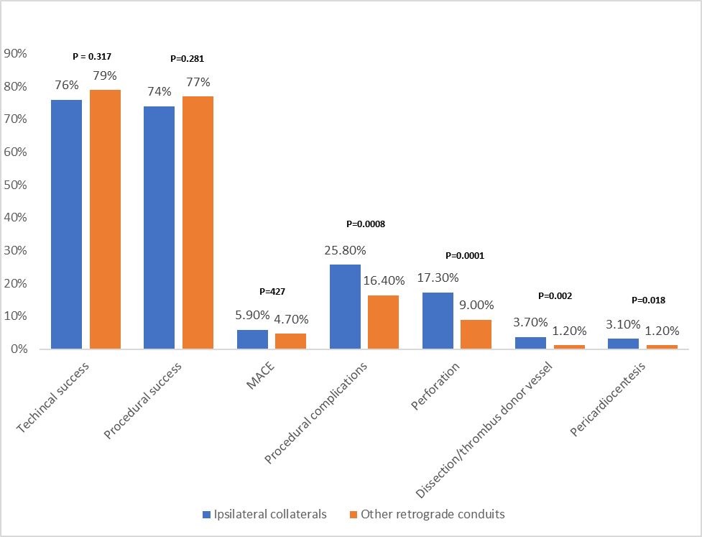
Comparison of outcomes and periprocedural complications of retrograde CTO PCI via ipsilateral epicardial vs. other connections.

Slide 21
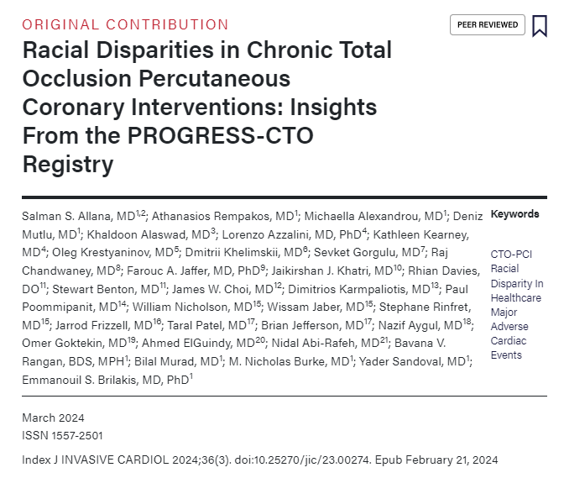
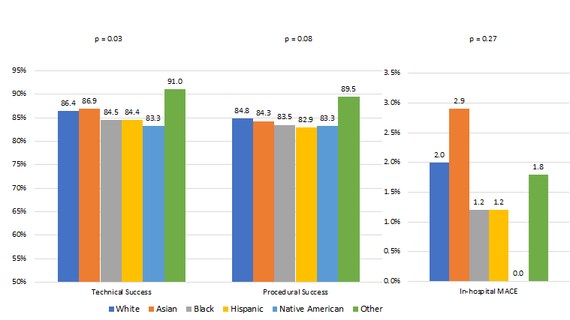
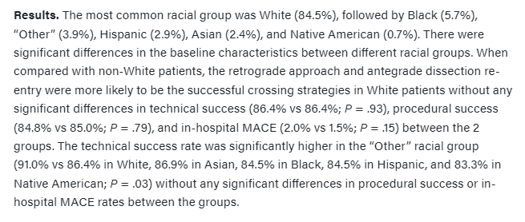
Despite differences in baseline characteristics and procedural techniques, the procedural success and in-hospital MACE of CTO PCI were not significantly different between most racial groups.

Slide 22
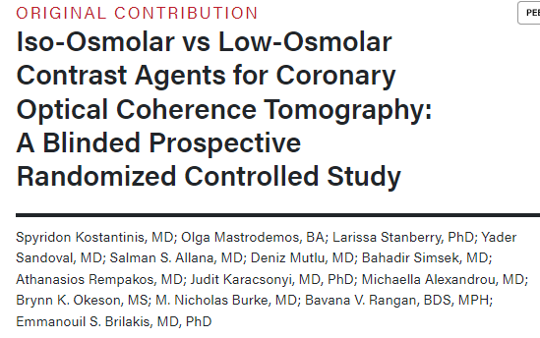
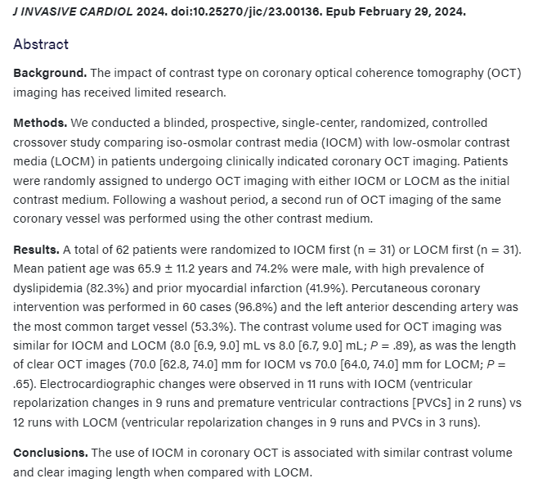
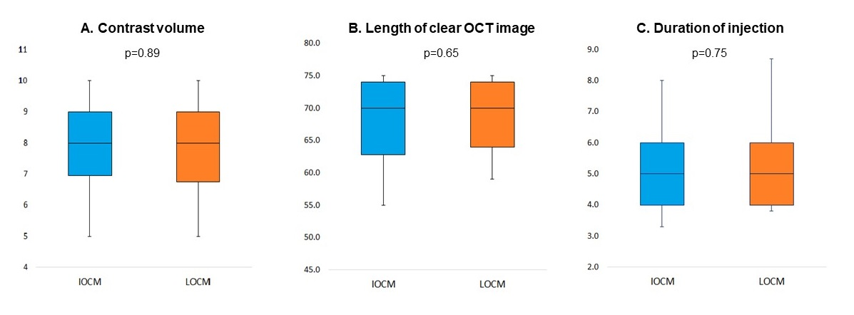
Figure: (A) Contrast volume, (B) length of clear optical coherence tomography (OCT) image, and (C) duration of injection with the use of iso-osmolar vs low-osmolar contrast media.
IOCM = iso-osmolar contrast media; LOCM = low-osmolar contrast media.

Slide 23
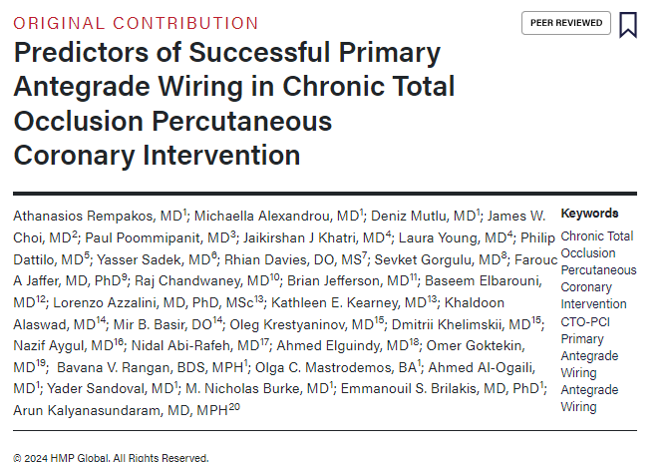
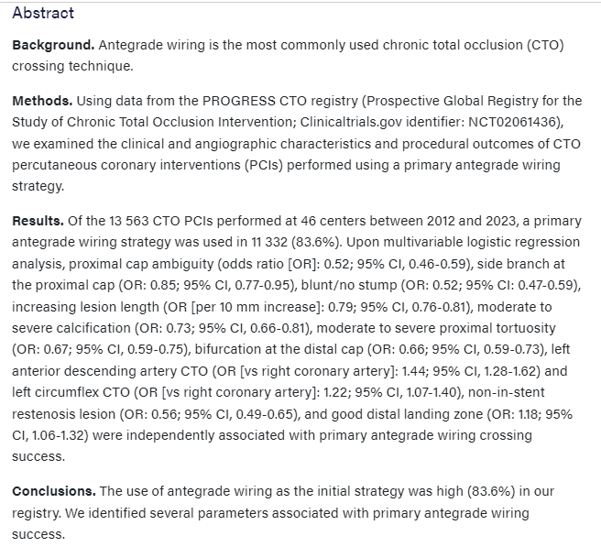
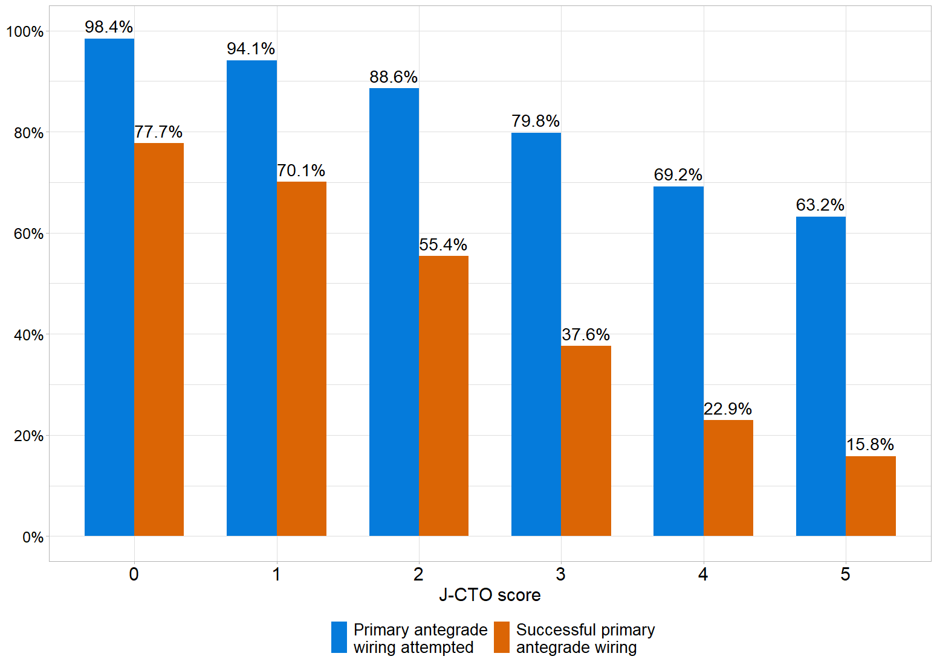
Figure: Primary antegrade wiring attempt and success rates by J-CTO score. J-CTO = Japanese Chronic Total Occlusion.

Slide 24
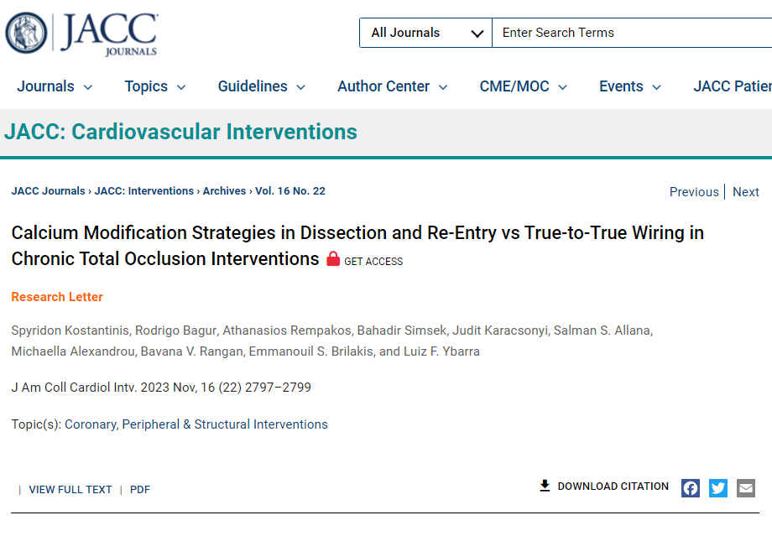
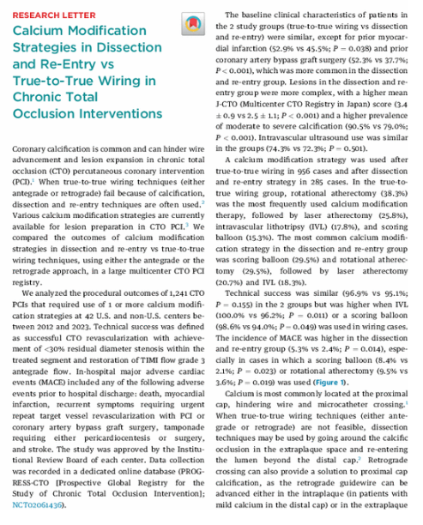
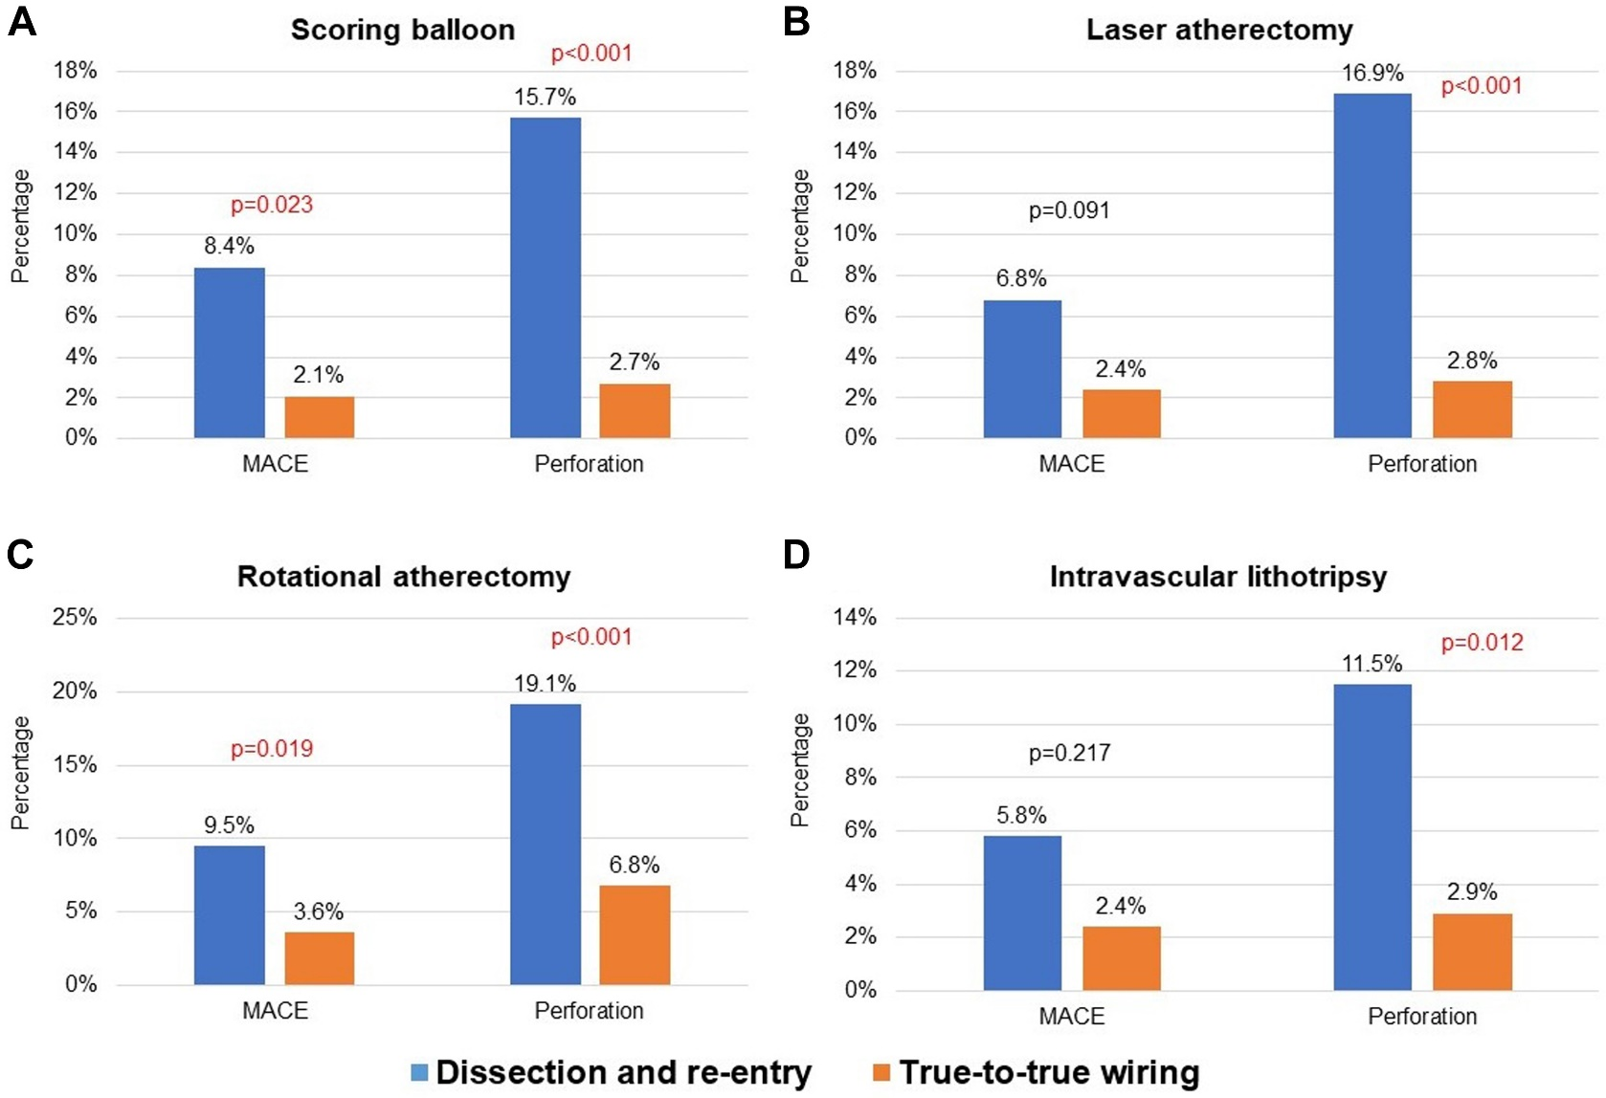
Figure 1. Incidence of MACE and Perforation in Dissection and Re-Entry vs True-to-True Wiring

Slide 25
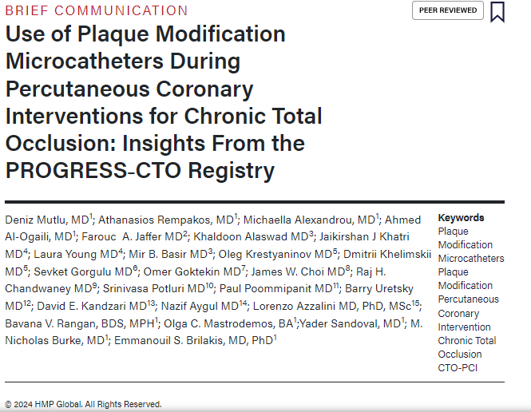
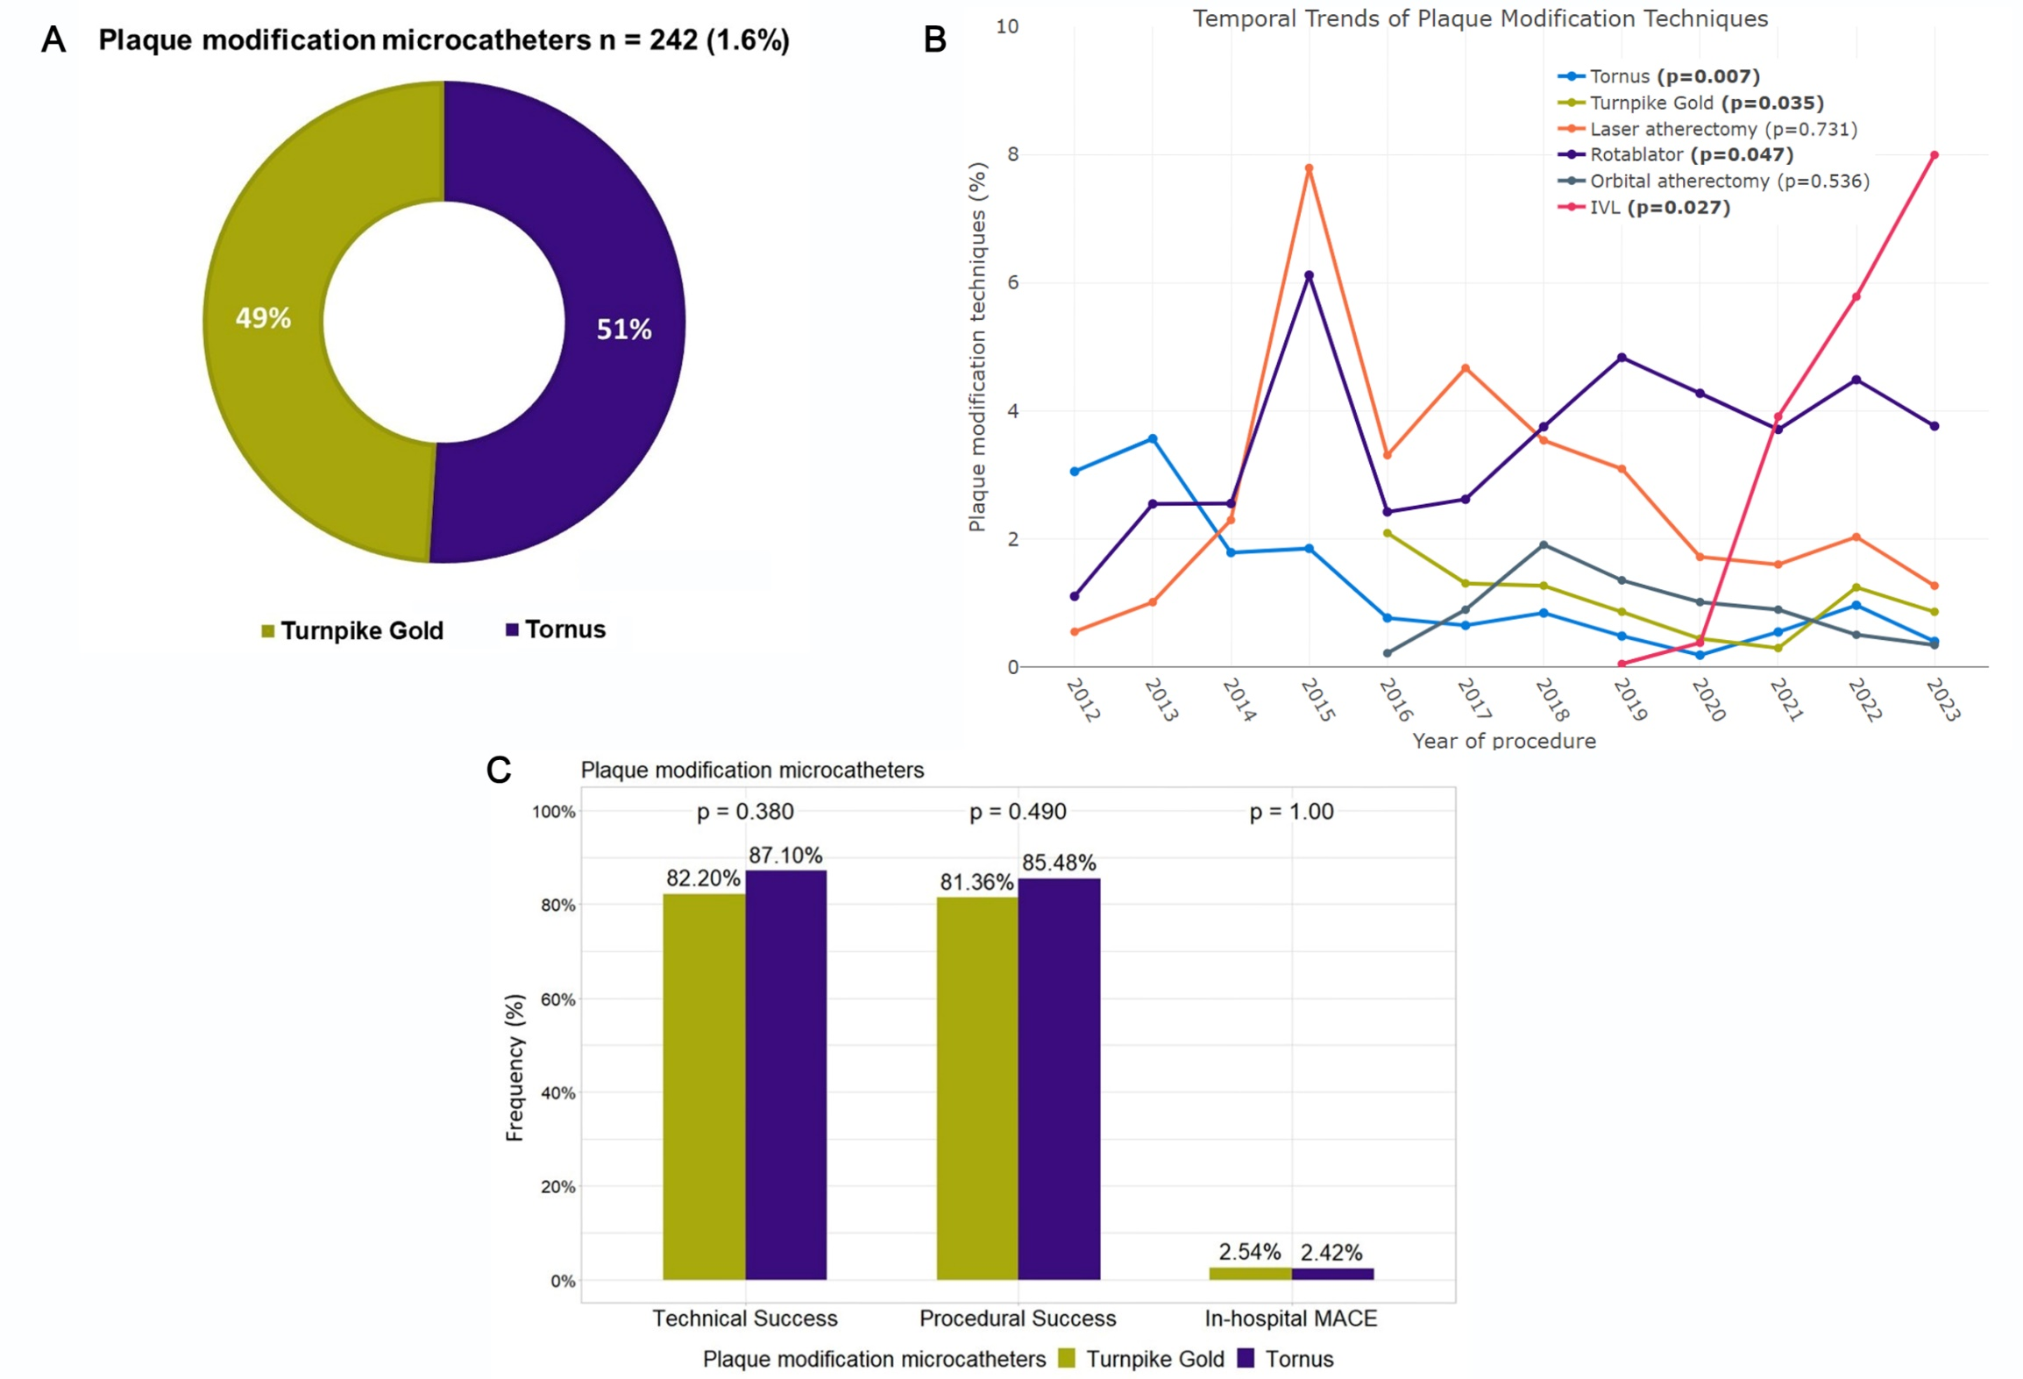
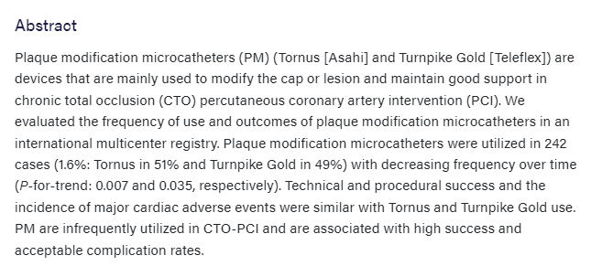
Figure. (A) Utilization of plaque modification microcatheters in the PROGRESS-CTO registry. (B) Temporal trends in use of plaque modification techniques. (C) Clinical outcomes with the Tornus (Asahi) and Turnpike Gold (Teleflex) microcatheters.

Slide 26
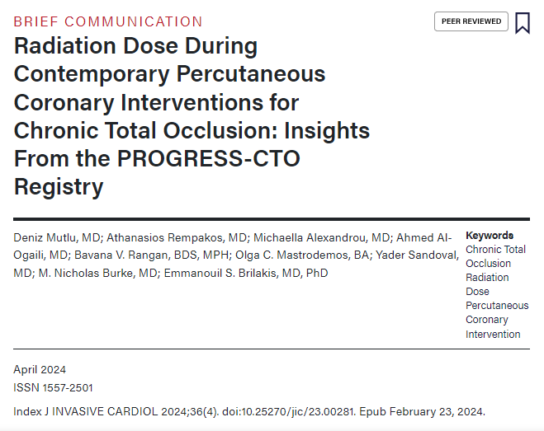
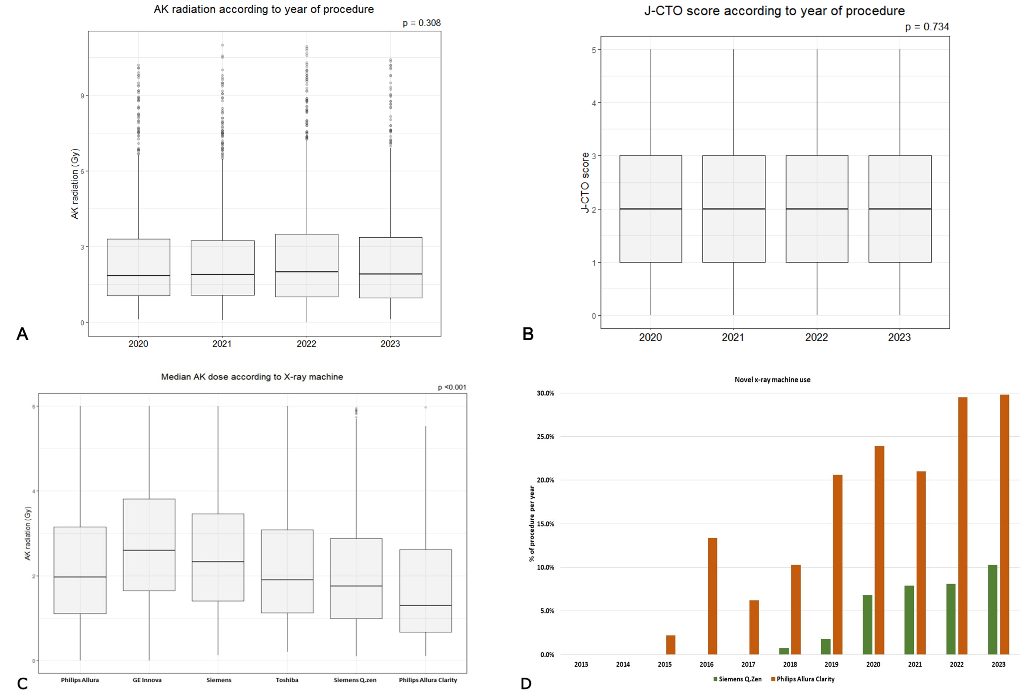
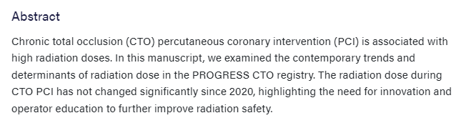

Slide 27



Figure: In hospital MACE and individual outcomes according to the ostial and non-ostial lesion location of CTO lesions.
Figure: Technical success, procedural success and in hospital MACE according to according to the ostial and non-ostial lesion location of CTO lesions.

Slide 28





Figure. Multiple logistic regression analysis for A) ischemic events and B) bleeding events. ACT = activated clotting time.
Figure. Restricted cubic splines for A) nadir ACT - ischemic events and B) peak ACT - bleeding events. ACT = activated clotting time.

Slide 29
E. PAST PUBLICATIONS

Slide 30


The use of ADR has been decreasing
ADR was used in more complex lesions and was associated with lower technical success and higher major adverse cardiac events compared with non-ADR cases
There has been a decrease in Stingray use and an increase in the use of STAR for re-entry

Slide 31


In our registry, IVL became the most commonly used technique for calcium modification in the last 2 years

Slide 32

In our registry, IVL became the most commonly used technique for calcium modification in the last 2 years

Slide 33


The first to report the outcomes of CTO PCI in the MENATA region
Included data from 10 centers in the MENATA region:
Turkey (5)
Egypt (2)
Lebanon (2)
India (1)

Slide 34


In our study, use of ZES and use of EES were associated with similar in-hospital and follow-up outcomes.

Slide 35




Slide 36





Slide 37




Slide 38





Panel A, A nomogram of the PROGRESS CTO MCS score. Panel B, Urgent mechanical circulatory support (MCS) use and receiver operator characteristics analyses of the PROGRESS CTO MCS score for models based on Gini index (M1), classification accuracy (M2), and using a joint set of M1/M2 variables (M3).

Slide 39





Slide 40





Slide 41





Fig. 1. In-hospital complications classified by quantity of calcium within the occluded vessel.
Fig. 2. Forest plot of multivariable analysis of parameters associated with technical success (Panel A) and MACE (Panel B).

Slide 42




Forest plot of multivariable analysis of parameters associated with guidewire manipulation time ≥30 minutes in patients with primary antegrade approach.

Slide 43




Multivariable logistic regression model for vascular complications. There was no significant association between bivalirudin and the risk of vascular access complications (OR, 1.76; 95% CI, 0.24-12.82).
Multivariable logistic regression model for net adverse cardiovascular events. After adjustment for potential confounders, the use of bivalirudin was not associated with an increased risk of NACE (odds ratio [OR], 0.99; 95% confidence interval [CI], 0.13-7.27).

Slide 44

LONG LESIONS
More comorbidities
Higher J-CTO score
Retrograde wiring more often
Longer procedure & fluoroscopy time
More contrast volume & higher air kerma radiation dose
Lower technical success and higher MACE, after adjustment.

Slide 45




Median number of guidewires used according to J-CTO score for (A) antegrade-only approach and (B) retrograde approach.
(A) Most commonly used guidewires for antegrade wiring. (B) Temporal trends on guidewires for antegrade wiring. (C) Most commonly used microcatheters for antegrade wiring. (D) Temporal trends on microcatheters for antegrade wiring.
(A) Most commonly used guidewires for retrograde approach. (B) Temporal trends on guidewires for retrograde approach. (C) Most commonly used microcatheters for retrograde approach. (D) Temporal trends on microcatheters for retrograde approach.
Notes:
Background. Guidewires and microcatheters are critical to the success of chronic total occlusion (CTO) percutaneous coronary intervention (PCI). Methods. We examined equipment utilization in 11,202 CTO-PCIs performed in 10,952 patients at 42 United States (US) and non-US centers between 2012 and 2022. Results. Antegrade-only crossing was attempted in 7628 CTO-PCIs (68%) and the retrograde approach was used in 3574 CTO-PCIs (32%). The median number of guidewires used during antegrade wiring increased with lesion complexity from 3 (interquartile range [IQR], 2-4) for J-CTO score of 0 to 5 (IQR, 4-7) for J-CTO score of 5 (P<.001). Antegrade-only procedures had higher technical (90% vs 79%; P<.001) and procedural success (89% vs 77%; P<.001) compared with retrograde procedures. In antegrade-only cases, Pilot 200 (28%; Abbott Vascular) and Fielder XT (24%; Asahi Intecc) were the most frequently used guidewires, while Corsair (21%; Asahi Intecc) and Turnpike Spiral (20%; Vascular Solutions) were the most commonly used microcatheters. In retrograde cases, Sion (32%; Asahi Intecc) was the most common guidewire used, followed by Sion Black (22%; Asahi Intecc), Pilot 200 (22%), and Suoh 03 (19%; Asahi Intecc), while Corsair (16%) and Turnpike LP (11%) were the most commonly used microcatheters. The most successful guidewire for collateral crossing was the Sion (32%), followed by Sion Black (15%) and Suoh 03 (11%). Conclusion. Polymer-jacketed guidewires are the most commonly used guidewires for antegrade wiring, while non-polymer-jacketed, torquable guidewires are the most frequently used guidewires for retrograde techniques. Turnpike and Corsair are the most commonly used microcatheters in CTO-PCI

Slide 46



Slide 47




Slide 48




Slide 49


21%
3%

Slide 50





Slide 51






Slide 52




Slide 53



Slide 54




Slide 55


Figure: Area under the receiver-operating characteristic (ROC) curve for the (A) MACE, (B) mortality, (C) pericardiocentesis, and (D) acute MI risk models.

Slide 56


Figure 1: Technical, procedural success and MACE classified
according to annual operator volume

Slide 57

Figure: Algorithm for approaching
de‐novo balloon undilatable lesions. CABG,
coronary artery bypass graft surgery; IVL,
intravascular lithotripsy; SIS OPN, very highpressure
balloon

Slide 58


Figure: Distribution of access sites used for CTO PCI in the
PROGRESS‐CTO registry. CTO, chronic total occlusion; PCI,
percutaneous coronary intervention

Slide 59




Slide 60





Slide 61

PROGRESS-Bifurcations
Focus: Bifurcation/ Trifurcation (Coronary Artery Branchpoint) Blockages
Overall Project Impact:
  Data from 742 cases
  6 participating centers
  3 countries (US, Russia, Turkey)
  14 publications, 10 conference presentations

Slide 62

COORDINATING CENTER AND CURRENTLY ENROLLING:
Minneapolis Heart Institute & Foundation
ENROLLING SITES:
Meshalkin Novosibirsk Research Institute, Novosibirsk, Russia
Ondokuz Mayis University, Turkey
Benzialem Vakif University, Istanbul, Turkey
Kartal Kosuyolu Postgraduate Training and Research Hospital, Istanbul, Turkey
Memorial Healthcare System, Florida, USA

Slide 63





www.progressbifurcation.org
ACC Scientific Sessions 2022
PCI Of Trifurcation Lesions: Insights From The Prospective Global Registry For The Study Of Bifurcation Lesion Interventions (PROGRESS-Bifurcation) Registry
-Judit Karacsonyi, MD
A data-driven cluster analysis to identify subgroups of bifurcation lesions based on their anatomical characteristics
-Ilias Nikolakopoulos, MD

Slide 64

PROGRESS Complications
Focus: Cardiac Catheterization and PCI procedure related complications
Overall Project Impact:
  Data from 529 cases
  3 centers
  8 publications, 2 conference presentations

Slide 65

COORDINATING CENTER AND CURRENTLY ENROLLING:
Minneapolis Heart Institute & Foundation
CURRENTLY ENROLLING:
University of Washington, Seattle, USA
Memorial Healthcare System, Seattle, USA

Slide 66





www.progresscomplications.org
Incidence, Treatment and Outcomes of Coronary Artery Dissection during Percutaneous Coronary Intervention
-Elizabeth Page et al., (SCAI poster and JIC publication) 2023
UPDATE WITH MICHAELLA

Slide 67

Laser for balloon uncrossable and undilatable chronic total occlusion interventions
Balloon uncrossable and balloon undilatable lesions represented 15.5% of all CTO PCIs. Laser was used in 20.3% and was associated with high technical and procedural success and similar major complication rates.
Karacsonyi J, Alaswad K, Choi JW, Vemmou E, Nikolakopoulos I, Poommipanit P, Rafeh NA, Elguindy A, Ungi I, Egred M, Brilakis ES
Interventional Journal of Cardiology 2021

Slide 68

In-Stent CTO Percutaneous Coronary Intervention: Individual Patient Data Pooled Analysis of 4 Multicenter Registries
Vemmou E, Quadros AS, Dens JA, Abi-Rafeh N, Agostoni P, Alaswad K, Avran A, Bellli KC, Carlino M, Choi JW, El-Guindy A, Jaffer FA, Karmpaliotis D, Khatri JJ, Khelimskii D, Knaapen P, La Manna A, Krestyaninov O. Lamelas P, Ojeda S, Padilla L, Pan M, Piccaro de Oliveira P, Rinfret S, Spratt JC, Tanabe M, Walsh S, Nikolakopoulos I, Karacsonyi J, Rangan BV, Brilakis ES, Azzalini L

Slide 69

Chronic total occlusion percutaneous coronary intervention in octogenarians and nonagenarians
Vemmou E, Alaswad K, Patel M, Mahmud E, Choi JW, Jaffer FA, Doing AH, Dattilo P, Karmpaliotis D, Krestyaninov O, Khelimskii D, Nikolakopoulos I, Karacsonyi J, Xenogiannis I, Garcia S, Burke MN, Abi Rafeh N, El-Guindy A, Goktekin O, Abdo A, Rangan BV, Abdullah S, Brilakis ES

Slide 70
Comparison of 3 Scores
Karacsonyi J, Stanberry L, Alaswad K, Krestyaninov O, Choi JW, Rangan BV, Nikolakopoulos I, Vemmou E, Ungi I, Brilakis ES.
Circ Cardiovascular Interventions

Slide 71
In-stent vs. de novo CTOs: same success rates
2012-2020
32 centers, 5,667 lesions
In-stent CTOs=913 (16% of total)
BASELINE ANGIOGRAPHIC AND TECHNICAL CHARACTERISTICS OF THE STUDY LESIONS
 | IS-CTOs n=913 | De novo CTOs n=4,754 | p-value
J-CTO score | 2.6±1.3 | 2.4±1.3 | 0.0002
-Lesion ≥20mm (%) | 80% | 65% | <0.0001
-Entry shape: blunt/no stump | 54% | 52% | 0.30
-Any evident calcification within CTO segment | 60% | 64% | 0.0213
-Tortuosity (bending >45° within CTO segment) | 37% | 40% | 0.21
-Previous attempt | 31% | 20% | <0.0001
Vemmou E, Alaswad K, Karmpaliotis D, Krestyaninov O, Khelimskii D, Xenogiannis I, Nikolakopoulos I, Rangan B, Brilakis ES
JACC Cardiovascular Interventions 2020​

Slide 72
Radiation
Vemmou E, Alaswad K, Khatri JJ, Nikolakopoulos I, Karacsonyi J, Xenogiannis I, Karmpaliotis D, Garcia S, Burke MN, Brilakis ES.
Circulation Cardiovascular Interventions

Slide 73
Equipment update
Nikolakopoulos I, Choi JW, Alaswad K, Khatri JJ, Krestyaninov O, Khelimskii D, Yeh RW, Jaffer FA, Toma C, Patel M, Mahmud E, Lembo NJ, Parikh M, Kirtane AJ, Ali ZA, Gkargkoulas F, Uretsky B,Sheikh AM, Vemmou E, Xenogiannis I, Rangan BV, Garcia S, Abdullah S, Banerjee S, Burke MN, Brilakis ES, Karmpaliotis D.
Catheter Cardiovasc Interv

Slide 74
Distal radial access
Nikolakopoulos I, Patel T, Jefferson BK, Sheikh AM, Jaber W, Samady H, Khatri JJ, Yeh RW, Tamez H, Koutouzis M, Tsiafoutis I, Jaffer FA, Doing AH, Dattilo P, Uretsky BF, Toma C, Elbarouni B, Alaswad K, Choi JW, Lembo NJ, Parikh M, Kirtane AJ, Ali ZA, Omer M, Vemmou E, Xenogiannis I, Karacsonyi J, Rangan BV, Abdulladh S, Banerjee S, Garcia S, Burke MN, Brilakis ES, Karmpaliotis D.
J Invasive Cardiology

Slide 75

CTO PCI via the radial approach
Tajti P, Alaswad K, Karmpaliotis D, Jaffer FA, Yeh RW, Patel MP, Mahmud E, Choi JW, Burke MN, Doing AH, Dattilo P, Toma C, Smith AJC, Uretsky B, Holper E, Potluri S, Wyman, MR, Kandzari DE, Garcia S, Krestyaninov O, Khelmiskii D, Koutouzis M, Tsiafoutis I, Khatri JJ, Jaber W, Samady H, Jefferson B, Patel T, Abdullah S, Moses JW, Lembo NJ, Parikh M, Kirtane AJ, Ali ZA, Doshi D, Xenogiannis I, Stanberry LI, Rangan BV, Ungi I, Banerjee S, Brilakis ES.
J Am Coll Cardiol Intv. 2018 [In press]

Slide 76

More than 1 CTO
Tajti P, Alaswad K, Karmpaliotis D, Jaffer FA, Yeh RW, Patel MP, Mahmud E, Choi JW, Burke MN, Doing AH, Toma C, Uretsky B, Holper E, Wyman, MR, Kandzari DE, Garcia S, Krestyaninov O, Khelmiskii D, Koutouzis M, Tsiafoutis I, Jaber W, Samady H, Moses JW, Lembo NJ, Parikh M, Kirtane AJ, Ali ZA, Doshi D, Xenogiannis I, Rangan BV, Ungi I, Banerjee S, Brilakis ES. Am J Cardiol. 2018 Aug 1;122(3):381-387.

Slide 77

Ad hoc vs planned CTO PCI
Sandoval Y, Tajti P, Karatasakis A, Burke MN, Danek BA, Karmpaliotis D, Alaswad K, Jaffer FA, Yeh RW, Patel MP, Mahmud E, Krestyaninov O, Khelimskii D, Choi JW, Doing AH, Toma C, Wyman RM, Uretsky BF, Garcia S, Koutouzis M, Tsiafoutis Y, Holper E, Moses JW, Lembo NJ, Parikh M, Kirtane AJ, Ali ZA, Doshi D, Kandzari DE, Karacsonyi J, Rangan BV, Banerjee S, Brilakis ES. J Invasive Cardiol. 2018 [In press]

Slide 78
Guide catheter extension rCART use in CTO PCI
Xenogiannis I, Karmpaliotis D, Alaswad K, Jaffer FA, Yeh RW, Patel M, Mahmud E, Choi JW, Burke MN, Doing AH, Dattilo P, Toma C, Smith AJC, Uretsky B, Krestyaninov O, Khelimskii D, Holper E, Potluri S, Wyman RM, Kandzari DE, Garcia S, Koutouzis M, Tsiafoutis I, Jaber W, Samady H, Moses JW, Lembo NJ, Parikh M, Kirtane AJ, Ali ZA, Doshi D, Tajti P, Rangan BV, Abdullah S, Banerjee S, Brilakis ES. J Invasive Cardiol. 2018 Nov 11. [Epub ahead of print]

Slide 79
Technical approach

Slide 80
Successful crossing strategy stratified by J-CTO score
p<0.0001

Slide 81
Successful crossing strategy stratified by PROGRESS CTO score

Slide 82
AK Radiation Dose
Contrast volume
p<0.0001
p<0.0001
AK Radiation dose (Gray)
Contrast volume (mL)
J-CTO
J-CTO

Slide 83
Procedural complications
p<0.0001
p<0.0001
p<0.0001
p=0.0171
p=0.1228
p=0.2999
p=0.2629
p=0.6637

Slide 84
Multivariable logistic regression

Slide 85



Slide 86
Concomitant
non-CTO
Xenogiannis I, Karmpaliotis D, Alaswad K, Jaffer FA, Yeh RW, Patel M, Mahmud E, Choi JW, Burke MN, Doing AH, Dattilo P, Toma K, Uretsky B, Krestyaninov O, Khelimskii D, Holper E, Potluri S, Wyman RM, Kandzari DE, Garcia S, Koutouzis M, Tsiafoutis I, Khatri JJ, Jaber W, Samady H, Jefferson BK, Patel T, Moses JW, Lembo NJ, Parikh M, Kirtane AJ, Ali ZA, Gkargkoulas F, Tajti P, Hall A, Rangan BV, Abdullah S, Banerjee S, Brilakis ES. Int J Cardiol 2019 [In press]

Slide 87


Left Main CTO PCI
Xenogiannis I, Karmpaliotis D, Alaswad K, Basir MR, Yeh RW, Tamez H, Patel M, Mahmud E, Choi JW, Burke MN, Doing AH, Dattilo P, Khatri JJ, Sheikhi AM, Malik BA, Greene ME, Abi Rafeh N, Maallouf A, Abou Jaoudeh F, Moses JW, Lembo NJ, Parikh M, Kirtane AJ, Ali ZA, Gkargkoulas F, Russo JJ, Hakemi E,Tajti P, Hall AB, Vemmou E, Nikolakopoulos I, Rangan BV, Abdullah S, Banerjee S, Brilakis ES. J Invasive Cardiol. 2018 [in press]

Slide 88

Use of the DyeVert System
Peter Tajti, MD; Iosif Xenogiannis, MD; Allison Hall, MD; M. Nicholas Burke, MD; Ivan Chavez, MD; Santiago Garcia, MD; Mario Gössl, MD, PhD; Michael Mooney, MD; Anil Poulose, MD; Paul Sorajja, MD; Yale Wang, MD; Evangelia Vemmou, MD; Ilias Nikolakopoulos, MD; Pamela Morley, RN; Bavana V. Rangan, BDS, MPH; Imre Ungi, MD, PhD; Emmanouil S. Brilakis, MD, PhD, J Invasive Cardiol 2019;31(9):253-259.

Slide 89
CKD vs no CKD
Tajti P, Karatasakis A, Danek BA, Alaswad K, Karmpaliotis D, Jaffer FA, Choi JW, Yeh RW, Patel MP, Mahmud E, Burke MN, Krestyaninov O, Khelimskii D, Toma C, Doing AH, Uretsky B, Koutouzis M, Tsiafoutis I, Wyman RM, Garcia S, Holper E, Xenogiannis I, Rangan BV, Banerjee S, Ungi I, Brilakis ES. J Invasive Cardiol. 2018 Nov;30(11):E113-E121. Epub 2018 Sep 15.

Slide 90
Atherectomy
Xenogiannis I, Karmpaliotis D, Alaswad K, Jaffer FA, Yeh RW, Patel M, Mahmud E, Choi JW, Burke MN, Doing AH, Dattilo P, Toma K, Smith AJC, Uretsky B, Krestyaninov O, Khelimskii D, Holper E, Potluri S, Wyman RM, Kandzari DE, Garcia S, Koutouzis M, Tsiafoutis I, Khatri JJ, Jaber W, Samady H, Jefferson BK, Patel T, Moses JW, Lembo NJ, Parikh M, Kirtane AJ, Ali ZA, Doshi D, Tajti P, Rangan BV, Abdullah S, Banerjee S, Brilakis ES. Am J Cardiol. 2019 May 1;123(9):1422-1428.

Slide 91
Ostial lesions
Tajti P, Burke MN, Karmpaliotis D, Alaswad K, Jaffer FA, Yeh RW, Patel M, Mahmud E, Choi JW, Doing AH, Datilo P, Toma C, Smith AJC, Uretsky B, Holper E, Garcia S, Krestyaninov O, Khelimskii D, Koutouzis M, Tsiafoutis I, Moses JW, Lembo NJ, Parikh M, Kirtane AJ, Ali ZA, Doshi D, Jaber W, Samady H, Rangan BV, Xenogiannis I, Ungi I, Banerjee S, Brilakis ES. Can J Cardiol. 2018 Oct;34(10):1264-1274.

Slide 92
Effect of Prior CABG
Pre Hybrid era
Hybrid era
Δ=9.1%
p<0.001
Δ=5%
p=0.001
  1,363 lesions; 3 US sites
  Prior CABG: 37%
  Complications: 1.5% vs. 2.1%
  Retrograde: 27.1% vs. 46.7%
  3486 lesions; 21 international sites
  Prior CABG: 32%
  Complications: 2.5% vs. 3.1%
  Retrograde: 30% vs. 53%
Tajti P, Karmpaliotis D, Alaswad K, Jaffer FA, Yeh RW, Patel M, Mahmud E, Choi JW, Burke MN, Doing AH, Dattilo P, Toma C, Smith AJC, Uretsky B, Holper E, Potluri S, Wyman RM, Kandzari DE, Garcia S, Krestyaninov O, Khelimskii D, Koutouzis M, Tsiafoutis I, Jaber W, Samady H, Moses JW, Lembo NJ, Parikh M, Kirtane AJ, Ali ZA, Doshi D, Xenogiannis I, Stanberry LI, Rangan BV, Ungi I, Banerjee S, Brilakis ES. Circ Cardiovasc Interv. 2019 Mar;12(3):e007338.
Michael, Karmpaliotis, Brilakis, Abdullah, Kirkland, Mishoe, Lembo, Kalynych, Carlson, Banerjee, Lombardi, Kandzari.
Heart 2013;99:1515-8
Notes:
92

Slide 93


www.ctomanual.org

Slide 94




Slide 95
Online score calculator:
www.progresscto.org

Slide 96


PROGRESS CTO score
Christopoulos, Kandzari, Yeh, Jaffer, Karmpaliotis, Wyman, Alaswad, Lombardi, Grantham, Moses, Christakopoulos, Tarar, Rangan, Lembo, Garcia, Cipher, Thompson, Banerjee, Brilakis. JACC Intv 2016;9:1–9

Slide 97
PROGRESS CTO score
PROGRESS score model
2/3 sampling rate for derivation set, 521 CTO lesions
PROGRESS
AUC=0.720
J-CTO
AUC=0.746
Variable | OR for technical failure (95% CI) | P-value | B coefficient | points
No Interventional collaterals | 2.40 (0.92-6.55) | 0.076 | 0.88 | 1
Proximal cap ambiguity | 3.86 (1.49-10.43) | 0.006 | 1.35 | 1
Moderate or severe tortuosity | 3.25 (1.22-9.28) | 0.021 | 1.18 | 1
LCX CTO | 2.69 (1.00-7.14) | 0.046 | 0.99 | 1
Prior PCI | 1.64 (0.54-6.13) | 0.391 | 0.25 | 0
Christopoulos, Kandzari, Yeh, Jaffer, Karmpaliotis, Wyman, Alaswad, Lombardi, Grantham, Moses, Christakopoulos, Tarar, Rangan, Lembo, Garcia, Cipher, Thompson, Banerjee, Brilakis. JACC Intv 2016 Jan 11;9(1):1-9

Slide 98

Christopoulos, Kandzari, Yeh, Jaffer, Karmpaliotis, Wyman, Alaswad, Lombardi, Grantham, Moses, Christakopoulos, Tarar, Rangan, Lembo, Garcia, Cipher, Thompson, Banerjee, Brilakis.
JACC Intv 2016 Jan 11;9(1):1-9

Slide 99


J-CTO score validation
ROC curve
Previous studies
Morino et al. AUC=0.82 for GW crossing<30 min
Area under curve=0.705 for final success
Rinfret et al.
AUC=0.77 for GW crossing <30 min
AUC=0.39 for final success
Christopoulos, Wyman, Alaswad, Karmpaliotis, Lombardi, Grantham, Yeh, Jaffer, Cipher, Rangan, Christakopoulos, Kypreos, Lembo, Kandzari, Garcia, Thompson, Banerjee, Brilakis
Circ Cardiovasc Interv 2015;8:e002171

Slide 100
J-CTO score validation
J-CTO score and CTO PCI approach
Procedural time and J-CTO score
1/2012 to 7/2014
6 centers, 650 lesions
Christopoulos, Wyman, Alaswad, Karmpaliotis, Lombardi, Grantham, Yeh, Jaffer, Cipher, Rangan, Christakopoulos, Kypreos, Lembo, Kandzari, Garcia, Thompson, Banerjee, Brilakis
Circ Cardiovasc Interv 2015;8:e002171

Slide 101
PROGRESS CTO complications score
11 centers, 1,569 lesions
In-hospital MACE 2.8%
MACE = MI, stroke, urgent re-PCI or CABG, tamponade requiring pericardiocentesis, death
Danek, Karatasakis, Karmpaliotis, Alaswad, Yeh, Jaffer, Patel, Mahmud, Lombardi, Wyman, Grantham, Doing, Kandzari, Lembo, Garcia, Toma, Moses, Kirtane, Parikh, Ali, Karacsonyi, Rangan, Thompson, Banerjee, Brilakis. JAHA 2016 Oct 11;5(10).

Slide 102
PROGRESS CTO complications score
Danek, Karatasakis, Karmpaliotis, Alaswad, Yeh, Jaffer, Patel, Mahmud, Lombardi, Wyman, Grantham, Doing, Kandzari, Lembo, Garcia, Toma, Moses, Kirtane, Parikh, Ali, Karacsonyi, Rangan, Thompson, Banerjee, Brilakis. JAHA 2016 Oct 11;5(10).

Slide 103

PROGRESS CTO complications score
Danek, Karatasakis, Karmpaliotis, Alaswad, Yeh, Jaffer, Patel, Mahmud, Lombardi, Wyman, Grantham, Doing, Kandzari, Lembo, Garcia, Toma, Moses, Kirtane, Parikh, Ali, Karacsonyi, Rangan, Thompson, Banerjee, Brilakis. JAHA 2016 Oct 11;5(10).

Slide 104

CTO score comparative analysis
2012 to 2016
13 centers, 664 lesions
(lesions from PROGRESS score derivation set excluded)
Technical success: 88%
Major complications: 3.6%
Karatasakis A, Danek BA, Karmpaliotis D, Alaswad K, Jaffer FA, Yeh RW, Patel MP, Bahadorani JN, Lombardi WL, Wyman RM, Grantham JA, Kandzari DE, Lembo NJ, Doing AH, Toma C, Moses JW, Kirtane AJ, Parikh M, Ali ZA, Garcia S, Kalsaria P, Karacsonyi J, Alame AJ, Thompson CA, Banerjee S, Brilakis ES.
Int J Cardiol. Aug 23;224:50-56

Slide 105

CTO score comparative analysis
Karatasakis A, Danek BA, Karmpaliotis D, Alaswad K, Jaffer FA, Yeh RW, Patel MP, Bahadorani JN, Lombardi WL, Wyman RM, Grantham JA, Kandzari DE, Lembo NJ, Doing AH, Toma C, Moses JW, Kirtane AJ, Parikh M, Ali ZA, Garcia S, Kalsaria P, Karacsonyi J, Alame AJ, Thompson CA, Banerjee S, Brilakis ES.
Int J Cardiol. Aug 23;224:50-56

Slide 106
Effect of age and sex
2012 to 2016
15 centers, 1,675 lesions
Technical success: 88%
Major complications: 2.7%
Karatasakis A, Iwnetu R, Danek BA, Karmpaliotis D, Alaswad K, Jaffer FA, Yeh RW, Kandzari DE, Lembo NJ, Patel MP, Mahmud E, Lombardi WL, Wyman RM, Grantham JA, Doing AH, Toma C, Choi JW, Uretsky BF, Moses JW, Kirtane AJ, Ali ZA, Parikh M, Karacsonyi J, Rangan BV, Thompson CA, Banerjee S, Brilakis ES.
J Invasive Cardiol. 2017 Jan

Slide 107

Lesion Age
Lesion number = 394
9 US centers
Median lesion age=12 months
Mean lesion age 43.3 months
1st tertile <5 months, 2nd tertile ≥5 months and <36.3 months, 3rd tertile ≥36.3 months
Danek, Karatasakis, Karmpaliotis, Alaswad, Yeh, Jaffer, Patel, Bahadorani, Lombardi, Wyman, Grantham, Doing, Moses, Kirtane, Parikh, Ali, Kalra, Kandzari, Lembo, Garcia, Nguyen-Trong, Karacsonyi, Alame, Kalsaria, Rangan, Thompson, Banerjee, Brilakis. Canadian Journal of Cardiology 2016 Apr 22

Slide 108
Lesion Age
N=394
Δ=5.2%
p=0.37
Δ=2.7%
p=0.80
Δ=3.3%
p=0.31
Danek, Karatasakis, Karmpaliotis, Alaswad, Yeh, Jaffer, Patel, Bahadorani, Lombardi, Wyman, Grantham, Doing, Moses, Kirtane, Parikh, Ali, Kalra, Kandzari, Lembo, Garcia, Nguyen-Trong, Karacsonyi, Alame, Kalsaria, Rangan, Thompson, Banerjee, Brilakis.
Canadian Journal of Cardiology 2016 Apr 22

Slide 109
Impact of prior failure
2012-2015
12 centers, 1,232 lesions
Prior failure: 17.5%
p=0.390
p=0.184
p=0.067
Karacsonyi, Karatasakis, Karmpaliotis, Alaswad, Yeh, Jaffer, Wyman, Lombardi, Grantham, Kandzari, Lembo, Moses, Kirtane, Parikh, Green, Finn, Garcia, Doing, Patel, Martinez Parachini, Resendes, Rangan, Ungi, Thompson, Banerjee, Brilakis.
Am J Cardiol 2016; 2016 Apr 15;117(8):1267-71

Slide 110
Antegrade Dissection Re-entry
Antegrade-only
All cases
Δ=1.5%
p=0.43
Δ=2.3%
p=0.23
Δ=3.3%
p<0.01
Δ=5.7%
p<0.01
1313 lesions; 11 US centers
ADR=458 (34.9%), ADR after exclusion of retrograde cases=248 (32.3% of 767 antegrade-only cases)
Complications 2.9 vs. 2.2% all cases, 1.5 vs. 0.6% antegrade-only
Danek, Karatasakis, Karmpaliotis, Alaswad, Yeh, Jaffer, Patel, Bahadorani, Lombardi, Wyman, Grantham, Doing, Moses, Kirtane, Parikh, Ali, Kalra, Kandzari, Lembo, Garcia, Rangan, Thompson, Banerjee, Brilakis.
Int J Cardiol 2016 Jul 1;214:428-37

Slide 111
Retrograde vs. antegrade-only: outcomes
2012-2015
11 centers, 1,301 lesions
Retrograde utilization: 41%
Δ= 8.9%
p<0.001
Δ=11.4%
p<0.001
Karmpaliotis D, Karatasakis A, Alaswad K, Jaffer FA, Yeh RW, Wyman RM, Lombardi W, Grantham JA, Kandzari DE, Lembo NJ, Doing A, Patel M, Bahadorani J, Moses JW, Kirtane AJ, Parikh M, Ali Z, Kalra S, Nguyen-Trong PJ, Danek BA, Karacsonyi J, Rangan BV, Roesle M, Thompson CA, Banerjee S, Brilakis ES. Circ Cardiovasc Interv 2016 Jun;9(6)

Slide 112
Retrograde vs. antegrade-only: in-hospital MACE
p<0.001
p=0.003
p=0.039
p=0.167
p=0.999
p=0.314
Karmpaliotis D, Karatasakis A, Alaswad K, Jaffer FA, Yeh RW, Wyman RM, Lombardi W, Grantham JA, Kandzari DE, Lembo NJ, Doing A, Patel M, Bahadorani J, Moses JW, Kirtane AJ, Parikh M, Ali Z, Kalra S, Nguyen-Trong PJ, Danek BA, Karacsonyi J, Rangan BV, Roesle M, Thompson CA, Banerjee S, Brilakis ES.
Circ Cardiovasc Interv 2016 Jun;9(6)

Slide 113
Antegrade guidewire utilization
2012-2015
15 centers, 1,011 lesions
AWE: 694 (69%)
Karatasakis, Tarar, Karmpaliotis, Alaswad, Yeh, Jaffer, Wyman, Lombardi, Grantham, Kandzari, Lembo, Moses, Kirtane, Parikh, Garcia, Doing, Pershad, Shah, Patel, Bahadorani, Shoultz Jr., Danek, Thompson, Banerjee, Brilakis.
Catheter Cardiovasc Interv 2016 May 17

Slide 114

Radiation exposure
2012-2015
9 centers, 748 lesions
Procedural success: 90%
Median AK dose: 3.4 (2.0, 5.4) Gray
Christakopoulos G, Christopoulos G, Karmpaliotis DK, Alaswad K, Yeh RW, Jaffer FA, Wyman MR, Lombardi WL, Tarar MNJ, Grantham JA, Kandzari DE, Lembo N, Moses JW, Kirtane AJ, Parikh M, Green P, Finn M, Garcia S, Doing AH, Hatem R, Thompson CA, Banerjee S, Brilakis ES.
Can J Cardiol 2017 Apr;33(4):478-484.

Slide 115
Radiation exposure - variables associated with AK dose
Variable | Univariable | Multivariable | p-value for univariable | p-value for multivariable
BMI (kg/m²) | 0.10 (0.017) | 0.08 (0.017) | <.0001 | <.0001
Dyslipidemia | 0.668 (0.236) | 0.10 (0.239) | 0.005 | 0.661
Hypertension | 0.335 (0.182) | 0.022 (0.172) | 0.066 | 0.9
Prior PCI | 0.31 (0.11) | 0.138 (0.109) | 0.005 | 0.208
Prior CABG | 0.633 (0.11) | 0.311 (0.110) | <0.001 | 0.005
Prior PVD | 0.267 (0.14) | 0.011 (0.137) | 0.058 | 0.936
Calcification (moderate/severe) | 0.762 (0.105) | 0.293 (0.116) | <.0001 | 0.012
Tortuosity (moderate/severe) | 0.402 (0.115) | 0.032 (0.113) | 0.005 | 0.778
Proximal cap ambiguity | 0.362 (0.126) | -0.250 (0.147) | 0.004 | 0.09
Distal cap at bifurcation | 0.374 (0.117) | 0.222 (0.113) | 0.002 | 0.051
J-CTO score | 0.60 (0.09) | 0.39 (0.12) | <.0001 | 0.001
Blunt/No stump | 1.208 (0.212) | 0.993 (0.247) | <.0001 | <.0001
Christakopoulos G, Christopoulos G, Karmpaliotis DK, Alaswad K, Yeh RW, Jaffer FA, Wyman MR, Lombardi WL, Tarar MNJ, Grantham JA, Kandzari DE, Lembo N, Moses JW, Kirtane AJ, Parikh M, Green P, Finn M, Garcia S, Doing AH, Hatem R, Thompson CA, Banerjee S, Brilakis ES.
Can J Cardiol (in press)

Slide 116

Contrast Utilization
2012-2015
12 centers, 1,330 lesions
Technical Success: 90%
Mean contrast: 289±138mL
Parameters independently associated with contrast
Christakopoulos GE, Karmpaliotis D, Alaswad K, Yeh RW, Jaffer FA, Wyman RM, Lombardi W, Grantham JA, Kandzari DE, Lembo NJ, Moses JW, Kirtane AJ, Parikh M, Green P, Finn M, Garcia S, Doing A, Patel M, Bahadorani J, Christopoulos G, Karatasakis A, Thompson CA, Banerjee S, Brilakis ES.
J Invasive Cardiol. 2016 Jul;28:288-94.

Slide 117
2012-2016
11 centers, 755 lesions
Balloon uncrossable: 9%
Balloon uncrossable lesions
Δ=7.8%
p<0.001
Δ=7.7%
p=0.004
Δ=0.6%
p=0.751
Techniques used to treat balloon uncrossable lesions
Karacsonyi J, Karmpaliotis D, Alaswad K, Jaffer FA, Yeh RW, Patel M, Bahadorani J, Doing A, Ali ZA, Karatasakis A, Danek BA, Rangan BV, Alame AJ, Banerjee S, Brilakis ES.
Catheter Cardiovasc Interv. 2016 Sep 21

Slide 118
Balloon uncrossable lesions
Microcatheters among study lesions
p=0.047
p<0.001
p<0.001
Karacsonyi J, Karmpaliotis D, Alaswad K, Jaffer FA, Yeh RW, Patel M, Bahadorani J, Doing A, Ali ZA, Karatasakis A, Danek BA, Rangan BV, Alame AJ, Banerjee S, Brilakis ES.
Catheter Cardiovasc Interv. 2016 Sep 21

Slide 119
Balloon undilatable lesions
2015-2017
10 centers, 425 lesions
Balloon undilatable: 12%
Tajti P, Karmpaliotis D, Alaswad K, Toma C, Choi JW, Jaffer FA, Doing AH, Patel M, Mahmud E, Uretsky B, Karatasakis A, Karacsonyi J, Danek BA, Rangan BV, Banerjee S, Ungi I, Brilakis ES.
Catheter Cardiovasc Interv. 2018 Jan 23

Slide 120


Side Branch Loss
Single center – Dallas VA; 109 lesions
Side branch loss occurred in 28 cases (25.7%)
Higher cardiovascular mortality (7.4% vs. 0%, log rank p=0.017)
Major complications: 1.8% (perforation with pericardiocentesis, stent thrombosis within 24 hours)
Nguyen-Trong PJ, Rangan BV, Karatasakis A, Danek BA, Christakopoulos GE, Martinez-Parachini JR, Resendes E, Ayers CR, Luna M, Abdullah S, Kumbhani DJ, Addo T, Grodin J, Banerjee S, Brilakis ES.
J Invasive Cardiol. 2016 Apr;28(4):168-73.

Slide 121

Intravascular imaging
2012-2015
7 centers, 619 lesions
Intravascular imaging: 38%
Karacsonyi J, Alaswad K, Jaffer FA, Yeh RW, Patel MP, Bahadorani JN, Karatasakis A, Danek BA, Doing AH, Grantham JA, Karmpaliotis D, Moses JW, Kirtane AJ, Parikh M, Ali Z, Lombardi WL, Kandzari DE, Lembo NJ, Garcia S, Wyman RM, Alame AJ, Nguyen-Trong PJ, Resendes E, Kalsaria P, Rangan BV, Ungi I, Thompson CA, Banerjee S, Brilakis ES.
J Am Heart Assoc. 2016 Aug 20;5(8)

Slide 122

Intravascular imaging
Purpose of intravascular imaging techniques
Karacsonyi J, Alaswad K, Jaffer FA, Yeh RW, Patel MP, Bahadorani JN, Karatasakis A, Danek BA, Doing AH, Grantham JA, Karmpaliotis D, Moses JW, Kirtane AJ, Parikh M, Ali Z, Lombardi WL, Kandzari DE, Lembo NJ, Garcia S, Wyman RM, Alame AJ, Nguyen-Trong PJ, Resendes E, Kalsaria P, Rangan BV, Ungi I, Thompson CA, Banerjee S, Brilakis ES.
J Am Heart Assoc. 2016 Aug 20;5(8)

Slide 123
Intravascular imaging
Δ=3.2%
p=0.302
Δ=1.8%
p=0.588
Δ=0.5%
p=0.772
Karacsonyi J, Alaswad K, Jaffer FA, Yeh RW, Patel MP, Bahadorani JN, Karatasakis A, Danek BA, Doing AH, Grantham JA, Karmpaliotis D, Moses JW, Kirtane AJ, Parikh M, Ali Z, Lombardi WL, Kandzari DE, Lembo NJ, Garcia S, Wyman RM, Alame AJ, Nguyen-Trong PJ, Resendes E, Kalsaria P, Rangan BV, Ungi I, Thompson CA, Banerjee S, Brilakis ES.
J Am Heart Assoc. 2016 Aug 20;5(8)

Slide 124

Crossing strategy selection (2015)
Christopoulos, Karmpaliotis, Alaswad, Yeh, Jaffer, Wyman, Lombardi, Menon, Grantham, Kandzari, Lembo, Moses, Kirtane, Parikh, Green, Finn, Garcia, Doing, Patel, Bahadorani, Tarar, Christakopoulos, Thompson, Banerjee, Brilakis.
Int J Cardiology 2015;198:222-228

Slide 125
In-hospital MACE based upon successful crossing strategy (2017)
3,122 lesions, 20 centers
Tajti , Karmpaliotis, Karmpaliotis, Alaswad, Jaffer, Yeh, Patel, Mahmud, Choi, Burke, Doing, Dattilo, Toma, Smith, Uretksy, Holper, Wyman, Kandzari, Garcia, Krestyaninov, Khelimskii, Koutouzis, Tsiafoutis, Moses, Lembo, Parikh, Kirtane, Doshi, Rangan, Ungi, Banerjee, Brilakis.
JACC Intv. [accepted for publication]

Slide 126
Success and target vessel
93%
636 lesions; 6 US centers
Retrograde more frequently in RCA intervention:
Initial strategy (26%), final successful strategy (33%)
Christopoulos, Karmpaliotis, Wyman, Alaswad, McCabe, Lombardi, Grantham, Marso, Kotsia, Rangan, Garcia, Lembo, Kandzari, Lee, Kalynych, Carlson, Thompson, Banerjee, Brilakis.
Can J Cardiol 2014;30:1588-94

Slide 127
Mode of failure
380 procedures
Appleton,
PeaceHealth
Mid America Heart Institute
Dallas VAMC
1 technical failure
Death from tamponade
n=33
9 technical successes
Death (n=1)
MI (n=4)
Urgent PCI (n=1)
Pericardiocentesis (n=3)
n=10
n=347
n=23
Failure to wire (n=18)
<TIMI 3 flow
Distal dissection (n=2)
Side branch loss (n=3)
Sapontis, Christopoulos, Grantham, Wyman, Alaswad, Karmpaliotis, Lombardi, McCabe, Marso, Kotsia, Rangan, Christakopoulos, Garcia, Thompson, Banerjee, Brilakis.
Cath Cardiovasc Interv 2015;85:1115-22

Slide 128
Radial vs femoral access
650 lesions; 6 US centers
Transradial (17%): mainly Appleton WI
Technical success: 92.6% femoral vs. 93% radial, p=0.87
Alaswad, Menon, Christopoulos, Lombardi, Karmpaliotis, Grantham, Marso, Wyman, Pokala, Patel, Kotsia, Rangan, Lembo, Kandzari, Lee, Kalynych, Carlson, Garcia, Thompson, Banerjee, Brilakis.
Cath Cardiovasc Intv 2015;85:1123-29

Slide 129
In-stent restenosis
Δ=3.3%
p=0.31
Δ=4.8%
p=0.18
642 lesions; 6 US centers
ISR=69 (10.7%) vs. De novo lesions=573
MACE: ISR 2.9% vs. De novo 1.6%
Christopoulos, Karmpaliotis, Alaswad, Lombardi, Grantham, Rangan, Kotsia, Lembo, Kandzari, Lee, Kalynych, Carlson, Garcia, Banerjee, Thompson, Brilakis.
Catheter Cardiovasc Interv. 2014;84:646-51

Slide 130
Impact of prior failure
Successful crossing strategy
Karacsonyi, Karatasakis, Karmpaliotis, Alaswad, Yeh, Jaffer, Wyman, Lombardi, Grantham, Kandzari, Lembo, Moses, Kirtane, Parikh, Green, Finn, Garcia, Doing, Patel, Martinez Parachini, Resendes, Rangan, Ungi, Thompson, Banerjee, Brilakis. Am J Cardiol 2016; 2016 Apr 15;117(8):1267-71

Slide 131

Impact of prior failure
p=0.893
p=0.163
p=0.015
Karacsonyi, Karatasakis, Karmpaliotis, Alaswad, Yeh, Jaffer, Wyman, Lombardi, Grantham, Kandzari, Lembo, Moses, Kirtane, Parikh, Green, Finn, Garcia, Doing, Patel, Martinez Parachini, Resendes, Rangan, Ungi, Thompson, Banerjee, Brilakis.
Am J Cardiol 2016; 2016 Apr 15;117(8):1267-71

Slide 132
Proximal cap ambiguity
2012-2015
11 centers, 1,021 lesions
Proximal cap ambiguity: 31%
Successful technique for lesions with ambiguous caps
Δ= 8%
p<0.001
Δ=7%
p=0.012
Karatasakis, Danek, Karmpaliotis, Alaswad, Jaffer, Yeh, Patel, Bahadorani, Wyman, Lombardi, Grantham, Kandzari, Lembo, Doing, Moses, Kirtane, Parikh, Ali, Garcia, Karacsonyi, Kalra, Kalsaria, Thompson, Banerjee, Brilakis.
J Invasive Cardiol. 2016 Oct;28(10):391-396.

Slide 133

Proximal cap ambiguity
Karatasakis, Danek, Karmpaliotis, Alaswad, Jaffer, Yeh, Patel, Bahadorani, Wyman, Lombardi, Grantham, Kandzari, Lembo, Doing, Moses, Kirtane, Parikh, Ali, Garcia, Karacsonyi, Kalra, Kalsaria, Thompson, Banerjee, Brilakis.
J Invasive Cardiol. 2016 Oct;28(10):391-396.

Slide 134

Use of SVGs in retrograde CTO PCI
2012-2015
4 centers, 572 lesions
Retrograde PCI: n=144 (25.2%)
Retrograde through SVG: n=21 (14.6% of retrograde)
Nguyen-Trong PJ, Alaswad K, Karmpaliotis D, Lombardi W, Grantham J, Lembo NJ, Kandzari DE, Karatasakis A, Karacsonyi J, Danek BA, Rangan BV, Roesle M, Ayers CR, Thompson CA, Banerjee S, Brilakis ES.
J Invasive Cardiol. 2016 Jun;28:218-24

Slide 135
Use of LIMA in retrograde CTO PCI
2012-2017
18 centers
Retrograde PCI: 990 lesions in 976 patients
Retrograde via LIMA: n=20 (2.02% of retrograde)
Tajti P, Karatasakis A, Karmpaliotis D, Alaswad K, Jaffer FA, Yeh RW, Patel M, Mahmud E, Choi JW, Doin AH, Toma C, Uretsky B, Garcia S, Moses JW, Parikh M, Kirtane AJ, Ali ZA, Hatem R, Karacsonyi J, Danek BA, Rangan BV, Ungi I, Banerjee S, Brilakis ES. J Invasive Cardiol. 2017 Nov 15 [Epub ahead of print]

Slide 136
Diabetes vs No diabetes
2012 to 2015
11 centers, 1,333 lesions
Technical success: 90.3%
Major complications: 2.4%
Successful crossing
p=0.80
p=0.93
Martinez Parachini, Karatasakis, Karmpaliotis, Alaswad, Jaffer, Yeh, Wyman, Lombardi, Grantham, Kandzari, Lembo, Doing, Patel, Bahadorani, Moses, Kirtane, Parikh, Ali, Kalra, Nguyen-Trong, Danek, Karacsonyi, Alame , Rangan, Thompson, Banerjee, Brilakis.
Diabet Med 2016 2017 Apr;34(4):558-562.

Slide 137
Diabetes vs No diabetes
p=0.001*
p=0.02*
p=0.043*
p=0.82
Martinez Parachini, Karatasakis, Karmpaliotis, Alaswad, Jaffer, Yeh, Wyman, Lombardi, Grantham, Kandzari, Lembo, Doing, Patel, Bahadorani, Moses, Kirtane, Parikh, Ali, Kalra, Nguyen-Trong, Danek, Karacsonyi, Alame , Rangan, Thompson, Banerjee, Brilakis.
Diabet Med 2016 2017 Apr;34(4):558-562.

Slide 138
Approaches to RCA CTOs
2012-2015
11 centers, 1,308 lesions
RCA CTOs: 56%
Technical success for RCA: 90%
Karatasakis A, Karmpaliotis D, Alaswad K, Jaffer FA, Yeh RW, Patel MP, Bahadorani JN, Lombardi WL, Wyman RM, Grantham JA, Kandzari DE, Lembo NJ, Doing AH, Toma C, Moses JW, Kirtane AJ, Ali Z, Parikh M, Garcia S, Danek BA, Karacsonyi J, Alame AJ, Kalsaria P, Thompson CA, Banerjee S, Brilakis ES.
EuroIntervention 2016 Dec 10;12(11)​

Slide 139

RCA CTOs: successful strategy according to lesion location
p=0.045
Technical success:
89%
89%
96%
79%
p=0.11
Karatasakis A, Karmpaliotis D, Alaswad K, Jaffer FA, Yeh RW, Patel MP, Bahadorani JN, Lombardi WL, Wyman RM, Grantham JA, Kandzari DE, Lembo NJ, Doing AH, Toma C, Moses JW, Kirtane AJ, Ali Z, Parikh M, Garcia S, Danek BA, Karacsonyi J, Alame AJ, Kalsaria P, Thompson CA, Banerjee S, Brilakis ES.
EuroIntervention 2016 Dec 10;12(11)​

Slide 140

CTO spatial distribution
2012-2016
13 centers, 1,369 lesions
Procedural success: 88%
Garcia S, Alraies MC, Karatasakis A, Yannopoulos D, Karmpaliotis D, Alaswad K, Jaffer FA, Yeh RW, Patel MP, Bahadorani JN, Karacsonyi J, Kalsaria P, Danek BA, Banerjee S, Brilakis ES.
Cath Cardiovasc Interv 2016 Nov 10.

Slide 141
Proximal vessel tortuosity
2012-2016
14 centers, 1,618 lesions
Moderate or severe proximal vessel tortuosity: 35.7%
Technical success overall: 90%
p<0.0001
p<0.0001
p=0.587
Karacsonyi J, Karmpaliotis D, Alaswad K, Jaffer FA, Yeh RW, Patel M, Mahmud E, Doing A, Toma C, Uretsky B, Choi J, Moses JW, Kirtane A, Parikh M, Ali Z, Lombardi WL, Kandzari DE, Lembo N, Garcia S, Wyman MR, Martinez-Parachini JR, Karatasakis A, Danek BA, Alame AJ, Resendes E, Rangan BV, Ungi I, Thompson CA, Banerjee S, Brilakis, ES. J Invasive Cardiol (in press)

Slide 142
Proximal vessel tortuosity
Guide support techniques among study lesions, classified according to proximal vessel tortuosity
p=0.085
p=0.001
p=0.002
p=0.124
Karacsonyi J, Karmpaliotis D, Alaswad K, Jaffer FA, Yeh RW, Patel M, Mahmud E, Doing A, Toma C, Uretsky B, Choi J, Moses JW, Kirtane A, Parikh M, Ali Z, Lombardi WL, Kandzari DE, Lembo N, Garcia S, Wyman MR, Martinez-Parachini JR, Karatasakis A, Danek BA, Alame AJ, Resendes E, Rangan BV, Ungi I, Thompson CA, Banerjee S, Brilakis, ES. J Invasive Cardiol (in press)

Slide 143
Calcification
2012-2016
11 centers, 1,476 lesions
Moderate or severe proximal vessel tortuosity: 57.7%
Technical success overall: 90%
p<0.0001
p<0.0001
p=0.033
Karacsonyi J, Karmpaliotis D, Alaswad K, Jaffer FA, Yeh RW, Patel M, Mahmud E, Lombardi W, Wyman MR, Doing A, Moses JW, Kirtane A, Parikh M, Ali Z, Kandzari D, Lembo N, Garcia S, Danek BA, Karatasakis A, Resendes E, Karsaria P, Rangan BV, Ungi I, Thompson CA, Banerjee S, Brilakis ES.
Am J Cardiol. 2017 Jul 1;120(1):40-46.

Slide 144

Guide catheter utilization in calcification
Karacsonyi J, Karmpaliotis D, Alaswad K, Jaffer FA, Yeh RW, Patel M, Mahmud E, Lombardi W, Wyman MR, Doing A, Moses JW, Kirtane A, Parikh M, Ali Z, Kandzari D, Lembo N, Garcia S, Danek BA, Karatasakis A, Resendes E, Karsaria P, Rangan BV, Ungi I, Thompson CA, Banerjee S, Brilakis ES.
Am J Cardiol. 2017 Jul 1;120(1):40-46.

Slide 145


Perforation
2012-2017
12 centers, 2,097 lesions
Incidence of perforation: 4.1% (85 patients)
Technical success overall: 88%
Danek BA, Karatasakis A, Tajti P, Sandoval Y, Karmpaliotis D, Alaswad K, Jaffer FA, Yeh RW, Kandzari DE, Lembo NJ, Patel MP, Mahmud E, Choi JW, Doing AH, Lombardi WL, Wyman MR, Toma C, Garcia S, Moses JW, Kirtane AJ, Hatem R, Ali ZA, Parikh M, Karacsonyi J, Rangan BV, Khalili H, Burke NM, Banerjee S, Brilakis ES. Am J Cardiol. 2017 Oct 15;120(8):1285-1292.

Slide 146

Perforation treatment
Danek BA, Karatasakis A, Tajti P, Sandoval Y, Karmpaliotis D, Alaswad K, Jaffer FA, Yeh RW, Kandzari DE, Lembo NJ, Patel MP, Mahmud E, Choi JW, Doing AH, Lombardi WL, Wyman MR, Toma C, Garcia S, Moses JW, Kirtane AJ, Hatem R, Ali ZA, Parikh M, Karacsonyi J, Rangan BV, Khalili H, Burke NM, Banerjee S, Brilakis ES. Am J Cardiol. 2017 Oct 15;120(8):1285-1292.

Slide 147

Mechanical circulatory support in CTO PCI
2012-2017
1,598 CTO PCIs at 12 high-volume centers
69 Elective (4%)
22 Urgent (1%)

Slide 148


Mechanical circulatory support
Danek BA, Basir MB, O'Neill WW, Alqarqaz M, Karatasakis A, Karmpaliotis D, Jaffer FA, Yeh RW, Wyman M, Lombardi WL, Kandzari D, Lembo N, Doing A, Patel M, Mahmud E, Choi JW, Toma C, Moses JW, Kirtane A, Parikh M, Ali ZA, Garcia S, Karacsonyi J, Rangan BV, Thompson CA, Banerjee S, Brilakis ES, Alaswad K.
J Invasive Cardiol. 2018 Mar;30(3):81-87.

Slide 149
Mechanical circulatory support
Danek BA, Basir MB, O'Neill WW, Alqarqaz M, Karatasakis A, Karmpaliotis D, Jaffer FA, Yeh RW, Wyman M, Lombardi WL, Kandzari D, Lembo N, Doing A, Patel M, Mahmud E, Choi JW, Toma C, Moses JW, Kirtane A, Parikh M, Ali ZA, Garcia S, Karacsonyi J, Rangan BV, Thompson CA, Banerjee S, Brilakis ES, Alaswad K.
J Invasive Cardiol. 2018 Mar;30(3):81-87.

