Slide 1



The Hybrid Approach to Percutaneous Coronary Intervention for Chronic Total Occlusion:
Update from the PROGRESS CTO International Registry
  Peter Tajti, MD
  on behalf of the PROGRESS CTO Investigators
  1. Minneapolis Heart Institute, Abbott Northwestern Hospital, MN, USA
  2. University of Szeged, Division of Invasive Cardiology, Second Department of Internal Medicine and Cardiology Center, Hungary

Slide 2
Disclosures
I, Peter Tajti DO NOT have a financial interest/arrangement or affiliation with one or more organizations that could be perceived as a real or apparent conflict of interest in the context of the subject of this presentation.

Slide 3
PROspective Global REgiStry for the Study of CTO interventions
www.progresscto.org
NCT02061436
35 Sites – Study PI: E. S. Brilakis – National coordinator: B.V. Rangan – Database manager: P. Tajti
Minneapolis VAMC, MN
S. Garcia
Beth Israel Deaconess MC, MA
R.W. Yeh
Appleton Cardiology, WI
K. Alaswad
PeaceHealth St. Joseph Medical Center, WA
W. Lombardi
Minneapolis Heart Institute, MN
N. Burke, E.S. Brilakis
Massachusetts General Hospital, MA
F. Jaffer
Henry Ford, MI
K. Alaswad
Columbia University, NY
D. Karmpaliotis, J. Moses, N. Lembo, A.J. Kirtane, R. Hatem, M. Parikh, Z. Ali
Northwestern Cardiovascular Institute, IL
M. Ricciardi
Torrance Medical Center, CA
M.R. Wyman
UPMC, PA
C. Toma, A.J. Conrad Smith
Medical Center of the Rockies, CO
A. Doing, P. Dattilo
Trinity Medical, NY
H. Meltser
CWRU, OH
M. Costa, H. Bezerra,
P. Poommipanit,
F. Forouzandeh
San Diego VAMC and UCSD, CA
E. Mahmud, M. Patel
Mid America Heart Institute, MO
J.A. Grantham
Maimonides MC, NY
B.A. Malik
Banner Samaritan Medical Center, AZ
A. Pershad
Tristar Centennial, TN
B. Jefferson, T. Patel
Carolina East HC, NC
D. Jessup, M. Groove, Alex R. Kirby
CAVHS, AR
B. Uretsky
Emory Hospital, GA
W. Jaber, H. Samady
UT Southwestern, TX
S. Banerjee
Dallas VAMC, TX
S. Abdullah, H. Khalili
Tulane, LA
N. Abi-Rafeh, O. Mogabgab
Piedmont Heart Institute, GA
D. Kandzari
Providence Health Center, TX
C. Shoultz
Baylor Dallas, TX
J. Choi
International sites:
Meshalkin Novosibirsk Research Institute, Russia,
O. Krestyaninov, D. Khelimskii
Korgialeneio-Benakeio Hellenic Red Cross Hospital, Greece,
M. Koutouzis, Y. Tsiafoutis
Henry Dunant Heart Hospital, Greece,
V.Tzifos, A. Kolyviras, D. Damaskos
Memorial Hospital, FL
L. Van-Thomas Crisco
Baylor Plano, TX
L. Holper
Funding: Abbott Northwestern Hospital Foundation
Houston Methodist, TX,
A. Shah

Slide 4
Hybrid algorithm
Brilakis ES, Grantham JA, Rinfret S, Wyman RM, Burke MN, Karmpaliotis D, Lembo N,
Pershad A, Kandzari DE, Buller CE, DeMartini T, Lombardi WL, Thompson CA.
JACC Cardiovasc Interv. 2012 Apr;5(4):367-79.

Slide 5
CTO PCI outcomes
Appleton Cardiology, WI
Baylor Heart and Vascular Hospital, TX
Beth Israel Deaconess Medical Center, MA
Columbia University, NY
Central Arkansas VAMC, AR
Dallas VAMC/UTSW, TX
Henry Ford Hospital, MI
Hellenic Red Cross General Hospital of Athens, Greece
Massachusetts General Hospital, MA
Medical Center of the Rockies, CO
Minneapolis VAMC, MN
Minneapolis Heart Institute, MN
Meshalkin Novosibirsk Research Institute, Russia
PeaceHealth St. Joseph MC, WA
Piedmont Heart Institute, GA
San Diego VAMC and UCSD, CA
St Luke’s Mid America Heart Institute, MO
The Heart Hospital Baylor Plano, TX
Torrance Medical Center, CA
UPMC Medical Center, PA
5/2012 to 12/2017
20 centers, 3,122 lesions in 3,055 patients

Slide 6
Baseline characteristics I
Clinical characteristics | Technical success (n=2657) | Technical failure (n=398) | p value
Age (years) * | 64.6 ± 10.2 | 66.0 ± 9.6 | 0.014
Male gender | 85% | 89% | 0.038
Diabetes | 44% | 40% | 0.176
Dyslipidemia | 92% | 93% | 0.678
Hypertension | 90% | 95% | 0.004
Family history of CAD | 33% | 33% | 0.842
CCS Angina Classification |  |  | 0.477
Class ≤1 | 12% | 10%
Class ≥2 | 88% | 90%
* mean ± SD; † median (IQR)

Slide 7
Baseline characteristics II
Clinical characteristics | Technical success (n=2657) | Technical failure (n=398) | p value
Prior MI | 45% | 54% | 0.002
Heart failure | 30% | 36% | 0.016
Prior PCI | 65% | 71% | 0.018
Prior CABG | 31% | 41% | <0.001
Baseline creatinine (mg/dL) † | 1.0 (0.9, 1.2) | 1.1 (0.9, 1.3) | 0.130
Prior CVD | 12% | 13% | 0.457
Prior PAD | 15% | 18.29% | 0.071
Left ventricular EF (%) † | 55 (44, 60) | 50 (40, 60) | 0.036
* mean ± SD; † median (IQR)

Slide 8
Angiographic characteristics I
Angiographic characteristics | Technical success (n=2711) | Technical failure (n=411) | p value
Target vessel |  |  | 0.064
RCA | 55% | 57%
LAD | 25% | 19%
LCX | 19% | 23%
Other | 1% | 1%
CTO length (mm)* | 33.4 ± 24.1 | 37.8 ± 24.0 | 0.003
Proximal cap ambiguity | 32% | 54% | <0.001
Blunt stump/no stump | 51% | 73% | <0.001
* mean ± SD; † median (IQR)

Slide 9
Angiographic characteristics II
Angiographic characteristics | Technical success (n=2711) | Technical failure (n=411) | p value
Side branch at proximal cap | 48% | 64% | <0.001
Interventional collaterals | 59% | 44% | <0.001
Moderate/severe calcification | 52% | 67% | <0.001
Moderate/severe tortuosity | 33% | 45% | <0.001
Previously failed CTO PCI | 19% | 27% | <0.001
J-CTO score * | 2.3 ± 1.3 | 3.1 ± 1.1 | <0.001
PROGRESS-CTO score * | 1.3 ± 1.0 | 1.8 ± 1.0 | <0.001
PROGRESS complication score * | 3.0 ± 1.9 | 3.5 ± 2.0 | <0.001
* mean ± SD; † median (IQR)

Slide 10
Technical approach

Slide 11
Successful crossing strategy stratified by J-CTO score
p<0.0001
ADR: antegrade dissection and re-entry
AWE: antegrade wire escalation

Slide 12
Successful crossing strategy stratified by PROGRESS CTO score
ADR: antegrade dissection and re-entry
AWE: antegrade wire escalation

Slide 13
AK Radiation Dose
Contrast volume
p<0.0001
p<0.0001
AK Radiation dose (Gray)
Contrast volume (mL)
J-CTO
J-CTO

Slide 14
Procedural complications
p<0.0001
p<0.0001
p<0.0001
p=0.0171
p=0.2999
p=0.2629
p=0.1228
p=0.6637
ADR: antegrade dissection and re-entry; AWE: antegrade wire escalation; CABG: coronary artery bypass graft; MI: myocardial infraction; PCI: percutaneous coronary intervention

Slide 15
Multivariable logistic regression

Slide 16
Conclusions
Hybrid approach for CTO PCI: high procedural success, acceptable complication rate
Higher annual CTO PCI volume is associated with higher procedural success
Our results provide important benchmarking for discussion of risk/benefit ratio of CTO PCI with patients/providers
Bridging the gap of what is currently achieved at most centers and what can be achieved should be a major focus of upcoming research and education

Slide 17
Limitations
Observational registry without adjudication of clinical events by an independent committee
Mid- and long-term follow ups of the study patients were not reported in the current study
Quantitative coronary angiographic analyses were not performed
Procedures were performed by experienced CTO PCI operators, limiting extrapolation of the results in less experienced centers and operators
Some centers only enrolled patients during part of the study period due to participation in other studies

Slide 18
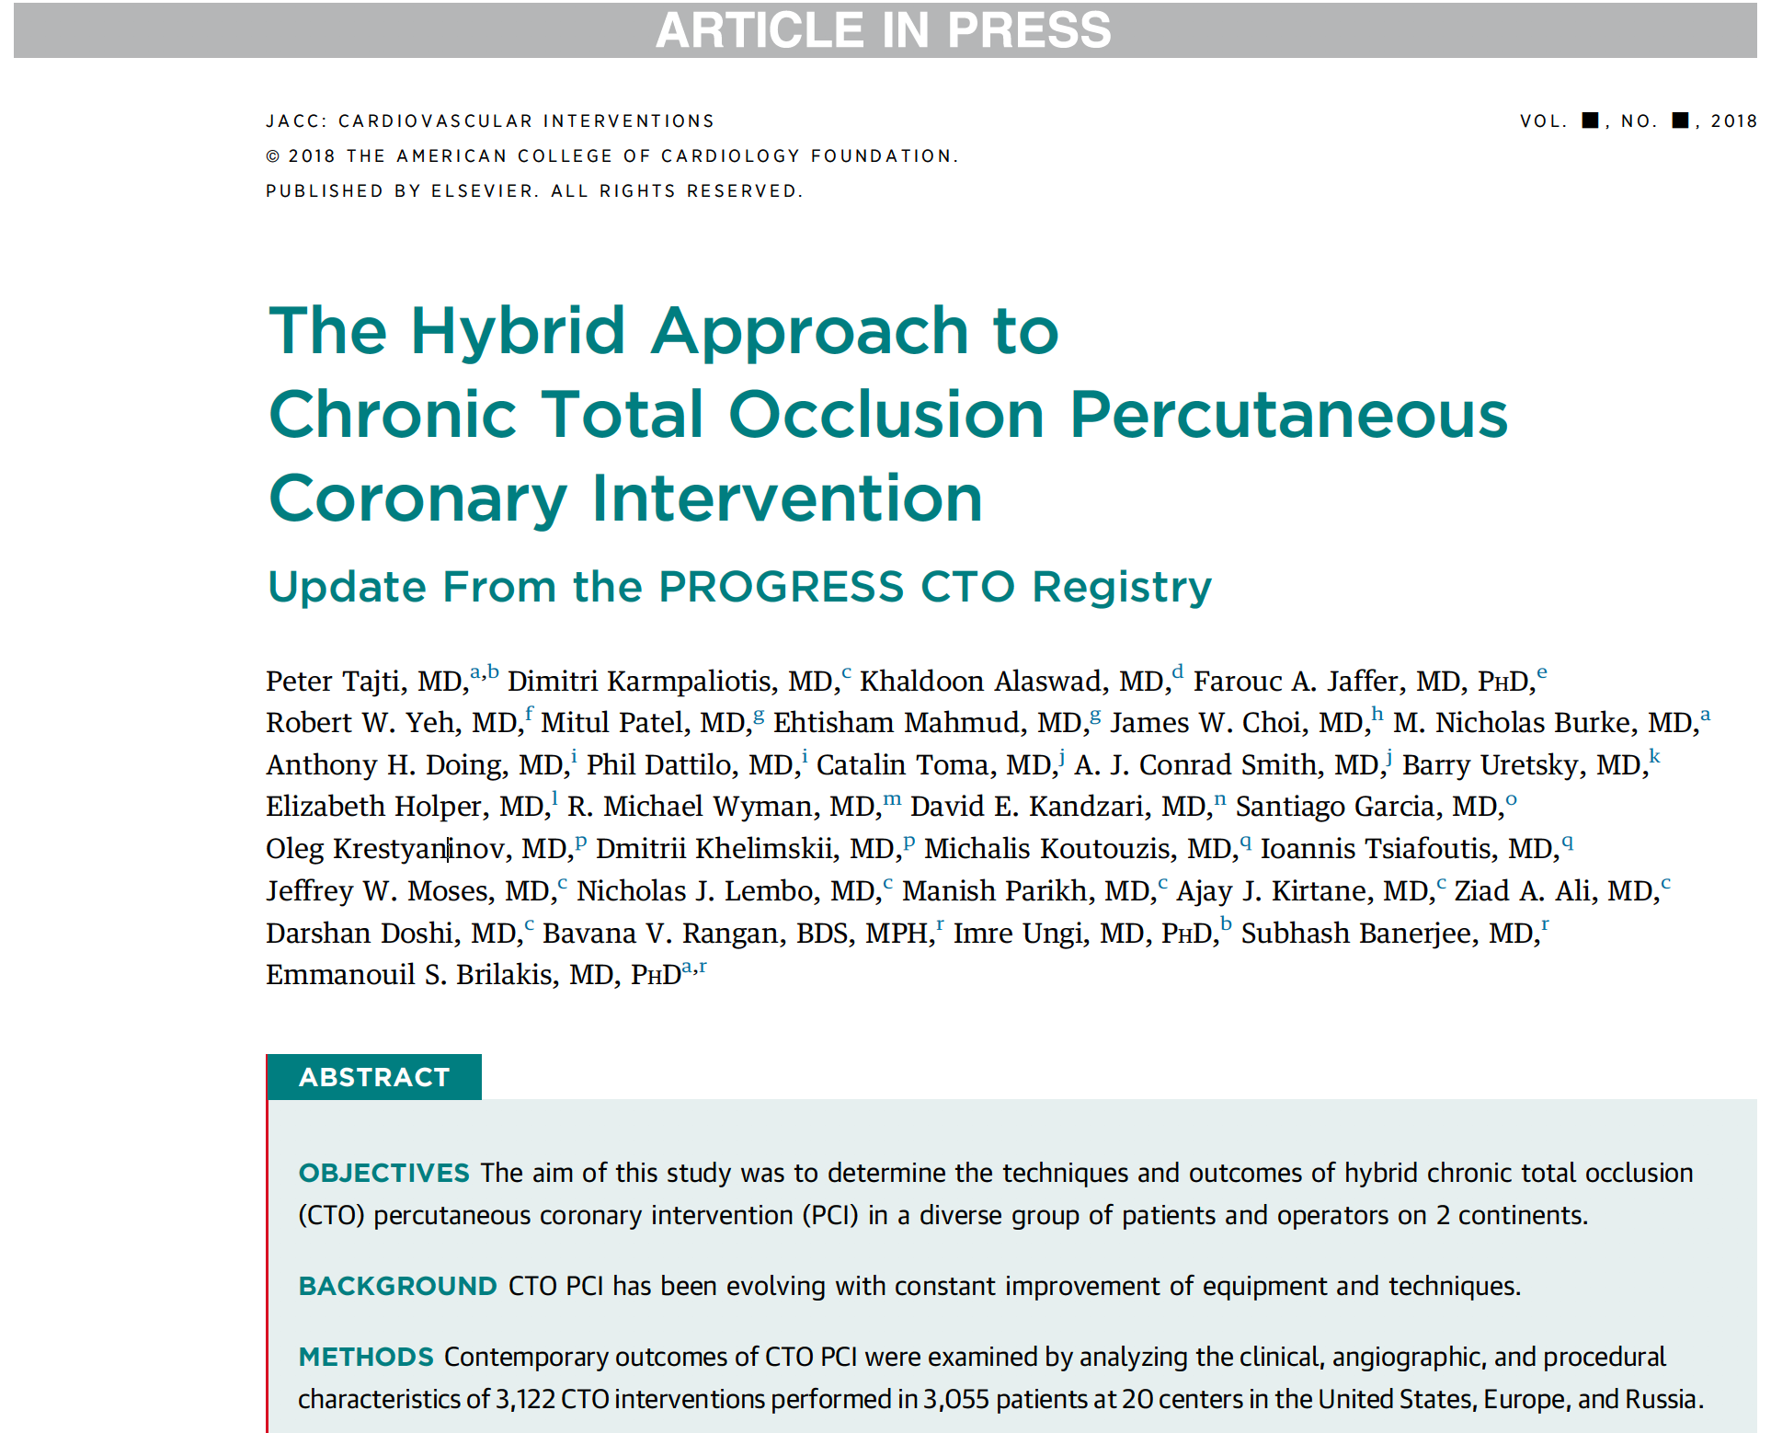

Slide 19

Thank you for your attention!
ptajti@gmail.com
@tajtipeter

