Slide 1
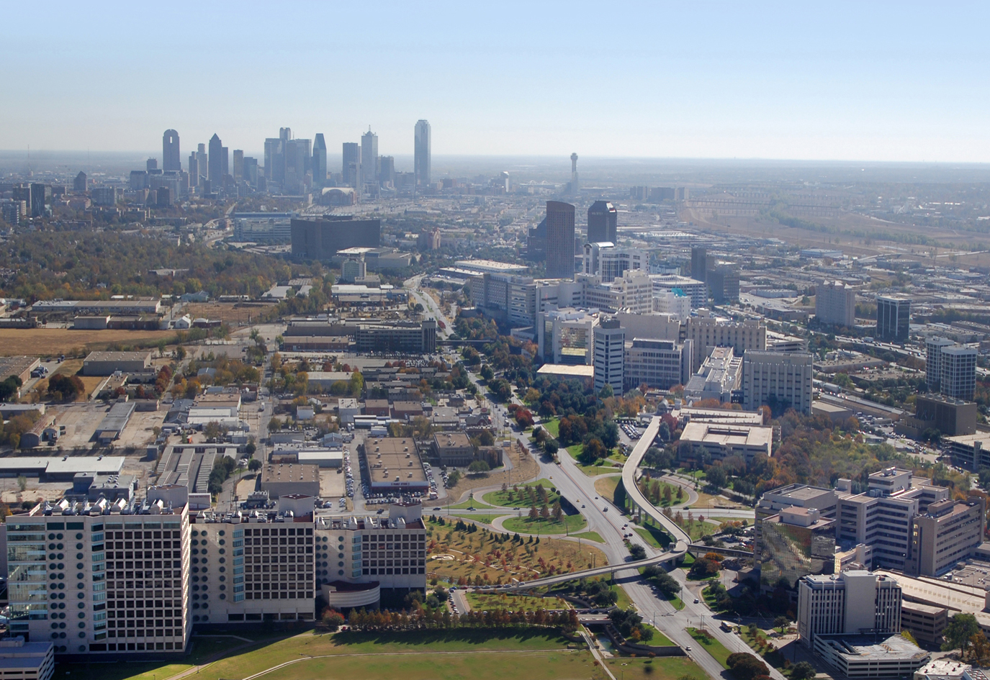
2016 CTO Summit
Friday, February 26, 2015
4.54-5.04 pm
Progress CTO Registry Update
Emmanouil S. Brilakis, MD, PhD
Director, Cardiac Catheterization Laboratories
VA North Texas Healthcare System
Professor of Medicine
UT Southwestern Medical School

Slide 2
ES Brilakis: Disclosures
Consulting/speaker honoraria: Abbott Vascular, Asahi, Boston Scientific, Elsevier, Somahlution, Terumo, St Jude
Employment (spouse): Medtronic
Grants: InfraRedx, Boston Scientific
VA - I01-CX000787-01
VA CSP#571 – DIVA
Notes:
2

Slide 3
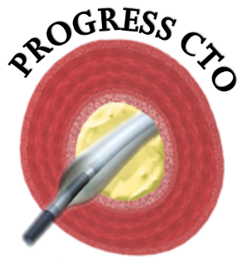
PROspective Global REgiStry for the Study of CTO interventions
www.progresscto.org
Appleton Cardiology, WI,
K. Alaswad
Minneapolis VA Medical Center, MN, S. Garcia
PeaceHealth St. Joseph Medical Center, WA,
W. Lombardi
Massachusetts General Hospital, MA,
F. Jaffer
B. Yeh
Medical Center of the Rockies, CO, A. Doing
Henry Ford, MI,
K. Alaswad
Columbia University, NY,
D. Karmpaliotis
Torrance Medical Center, CA,
M.R. Wyman
Mid America Heart Institute, MO, J.A. Grantham
Denver VAMC, CO,
E. Armstrong
UPMC
C. Toma
Carolina East MC, NC D. Jessup
San Diego VAMC and University of California, CA
M. Patel
Little Rock VAMC, B. Uretsky
Dallas VAMC and UTSW, TX,
E.S. Brilakis
Piedmont Heart Institute, GA,
D. Kandzari
N. Lembo
Providence Health Center, TX, C. Shoultz
Banner Samaritan Medical Center, AZ, A. Pershad
Baylor Dallas, TX,
J. Choi
Houston VAMC, TX,
A. Denktas
23 sites
Sponsors: DVARC and UTSW
National coordinator: BV Rangan
Database manager: A Karatasakis
Houston Methodist, TX,
A. Shah
Tulane
N Abi-Rafeh, O Mogabgab

Slide 4
PROspective Global REgiStry for the Study of CTO interventions
www.progresscto.org
Overall update
PROGRESS CTO score
Prior CTO PCI failure
Proximal cap ambiguity
CTO age
Radiation
Antegrade guidewire utilization
Retrograde Analysis
RCA CTO
Hemodynamic support
Imaging
Bifurcations

Slide 5
PROspective Global REgiStry for the Study of CTO interventions
Appleton Cardiology, WI
Columbia University, NY
Dallas VAMC/UTSW, TX
Henry Ford Hospital, MI
Massachusetts General Hospital, MA
Medical Center of the Rockies, CO
Minneapolis VAMC, MN
Peaceheath Bellingham, WA
Piedmont Heart Institute, GA
San Diego VAMC and UCSD, CA
St Luke’s Mid America Heart Institute, MO
Torrance Medical Center, CA
UPMC Medical Center, PA
1/2012 to 2/2016
13 centers, 1,632 lesions
Technical success: 89%
Major complications: 2.7%
0.6% mortality, 1.0% MI
0.9% pericardiocentesis, 0.2% stroke
0.1% CABG, 0.2% re-PCI
Successful technique

Slide 6
PROspective Global REgiStry for the Study of CTO interventions
www.progresscto.org
Overall update
PROGRESS CTO score
Prior CTO PCI failure
Proximal cap ambiguity
CTO age
Radiation
Antegrade guidewire utilization
Retrograde Analysis
RCA CTO
Hemodynamic support
Imaging
Bifurcations

Slide 7
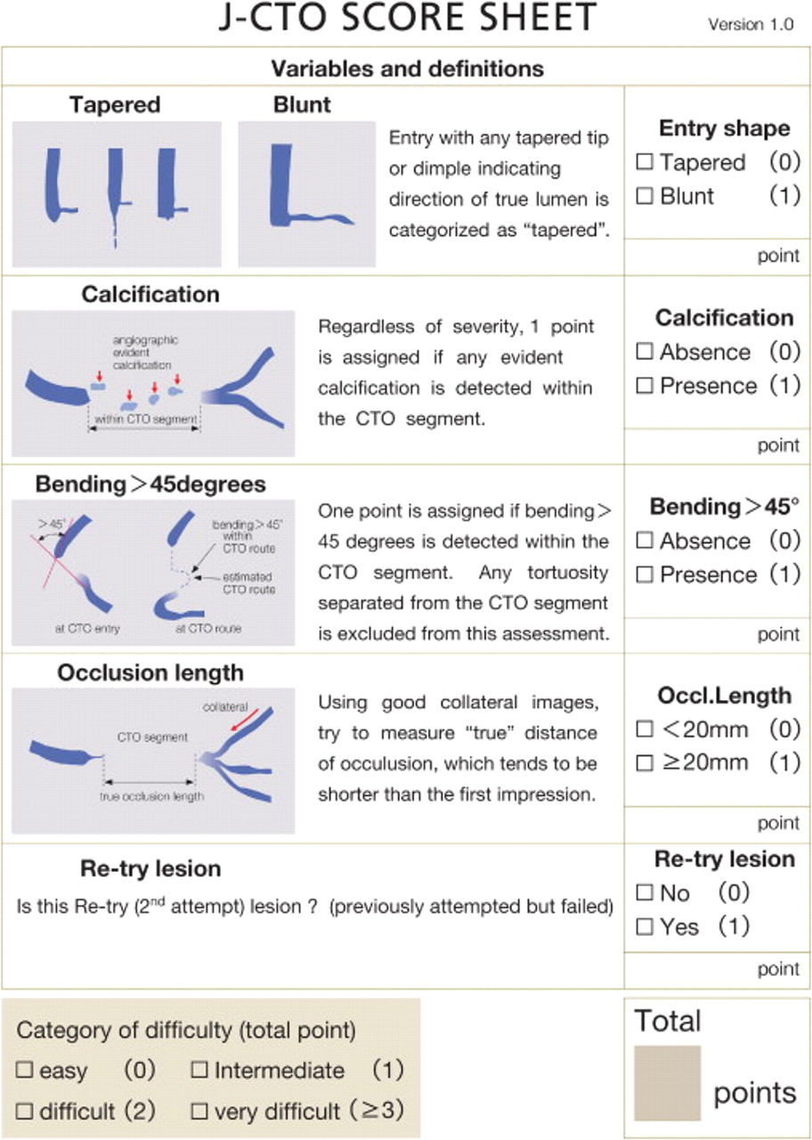
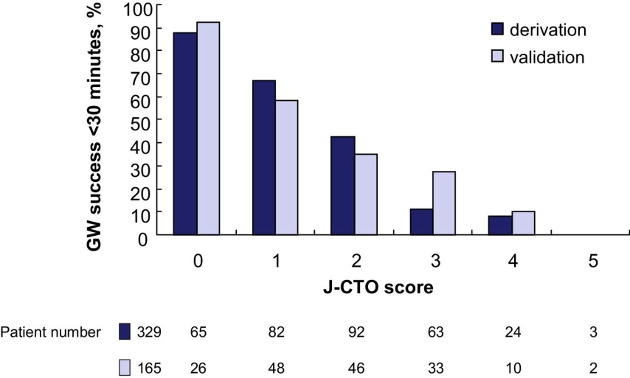
J-CTO Score
494 native CTO lesions
Crossing within 30 minutes
Morino, Y. et al. JACC Intv 2011;4:213-221

Slide 8
PROspective Global REgiStry for the Study of CTO interventions
J-CTO score validation
J-CTO score and CTO PCI approach
Procedural time and J-CTO score
1/2012 to 7/2014
6 centers, n=650 lesions
Christopoulos, Wyman, Alaswad, Karmpaliotis, Lombardi, Grantham, Yeh, Jaffer, Cipher, Rangan, Christakopoulos, Kypreos, Lembo, Kandzari, Garcia, Thompson, Banerjee, Brilakis.
Circ Cardiovasc Interv. 2015;8:e002171

Slide 9
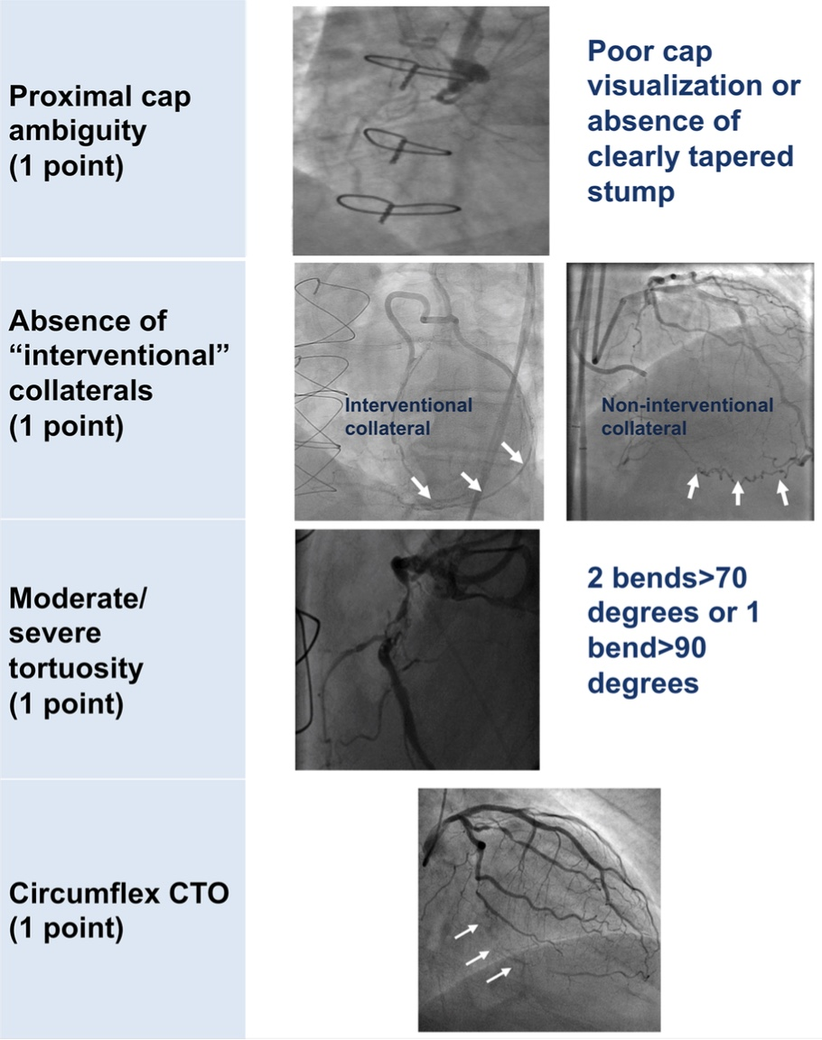
Progress CTO score
Christopoulos, Kandzari, Yeh, Jaffer, Karmpaliotis, Wyman, Alaswad, Lombardi, Grantham, Moses, Christakopoulos, Tarar, Rangan, Lembo, Garcia, Cipher, Thompson, Banerjee, Brilakis. JACC Intv 2016;9:1–9

Slide 10
PROspective Global REgiStry for the Study of CTO interventions
www.progresscto.org
781 patients
7 US centers
2012-2015
Technical success (%)
PROGRESS CTO score
Christopoulos, Kandzari, Yeh, Jaffer, Karmpaliotis, Wyman, Alaswad, Lombardi, Grantham, Moses, Christakopoulos, Tarar, Rangan, Lembo, Garcia, Cipher, Thompson, Banerjee, Brilakis. JACC Intv 2016;9:1–9

Slide 11
 | J-CTO | CL | Progress-CTO
Number of variables | 5 | 6 | 4
Number of cases | 494 | 1,657 | 781
Overall success | 88.6% (guidewire crossing) | 72.5% (procedural) | 92.9% (technical)
Clinical
Prior CABG |  | +
Prior MI |  | +
Prior CTO PCI failure | +
Angiographic
Blunt stump | + | + | +
Severe calcification | + | +
Severe tortuosity | + |  | +
CTO length>20 mm | + | +
CTO target vessel |  | + (non-LAD) | + (circumflex)
Collaterals |  |  | +

Slide 12
PROspective Global REgiStry for the Study of CTO interventions
www.progresscto.org
Overall update
PROGRESS CTO score
Prior CTO PCI failure
Proximal cap ambiguity
CTO age
Radiation
Antegrade guidewire utilization
Retrograde Analysis
RCA CTO
Hemodynamic support
Imaging
Bifurcations

Slide 13
PROspective Global REgiStry for the Study of CTO interventions
Impact of prior failure
2012-2015
12 centers, 1,232 lesions
Prior failure: 17.5%
P=0.390
P=0.184
P=0.067
Karacsonyi, Karatasakis, Karmpaliotis, Alaswad, Yeh, Jaffer, Wyman, Lombardi, Grantham, Kandzari, Lembo, Moses, Kirtane, Parikh, Green, Finn, Garcia, Doing, Patel, Martinez Parachini, Resendes, Rangan, Ungi, Thompson, Banerjee, Brilakis.
Am J Cardiol 2016; in press

Slide 14
PROspective Global REgiStry for the Study of CTO interventions
Impact of prior failure
Successful crossing strategy
Karacsonyi, Karatasakis, Karmpaliotis, Alaswad, Yeh, Jaffer, Wyman, Lombardi, Grantham, Kandzari, Lembo, Moses, Kirtane, Parikh, Green, Finn, Garcia, Doing, Patel, Martinez Parachini, Resendes, Rangan, Ungi, Thompson, Banerjee, Brilakis.
Am J Cardiol 2016; in press

Slide 15
PROspective Global REgiStry for the Study of CTO interventions
Impact of prior failure
P=0.893
P=0.163
P=0.015
Karacsonyi, Karatasakis, Karmpaliotis, Alaswad, Yeh, Jaffer, Wyman, Lombardi, Grantham, Kandzari, Lembo, Moses, Kirtane, Parikh, Green, Finn, Garcia, Doing, Patel, Martinez Parachini, Resendes, Rangan, Ungi, Thompson, Banerjee, Brilakis.
Am J Cardiol 2016; in press

Slide 16
PROspective Global REgiStry for the Study of CTO interventions
www.progresscto.org
Overall update
PROGRESS CTO score
Prior CTO PCI failure
Proximal cap ambiguity
CTO age
Radiation
Antegrade guidewire utilization
Retrograde Analysis
RCA CTO
Hemodynamic support
Imaging
Bifurcations

Slide 17
PROspective Global REgiStry for the Study of CTO interventions
Proximal cap ambiguity
Successful technique for lesions with ambiguous caps
2012-2015
11 centers, 1,021 lesions
Proximal cap ambiguity: 31%
Δ= 8%
P<0.001
Δ=7%
P=0.012
Karatasakis, Danek, Karmpaliotis, Alaswad, Jaffer, Yeh, Patel, Bahadorani, Wyman, Lombardi, Grantham, Kandzari, Lembo, Doing, Moses, Kirtane, Parikh, Ali, Garcia, Karacsonyi, Kalra, Kalsaria, Thompson, Banerjee, Brilakis.

Slide 18
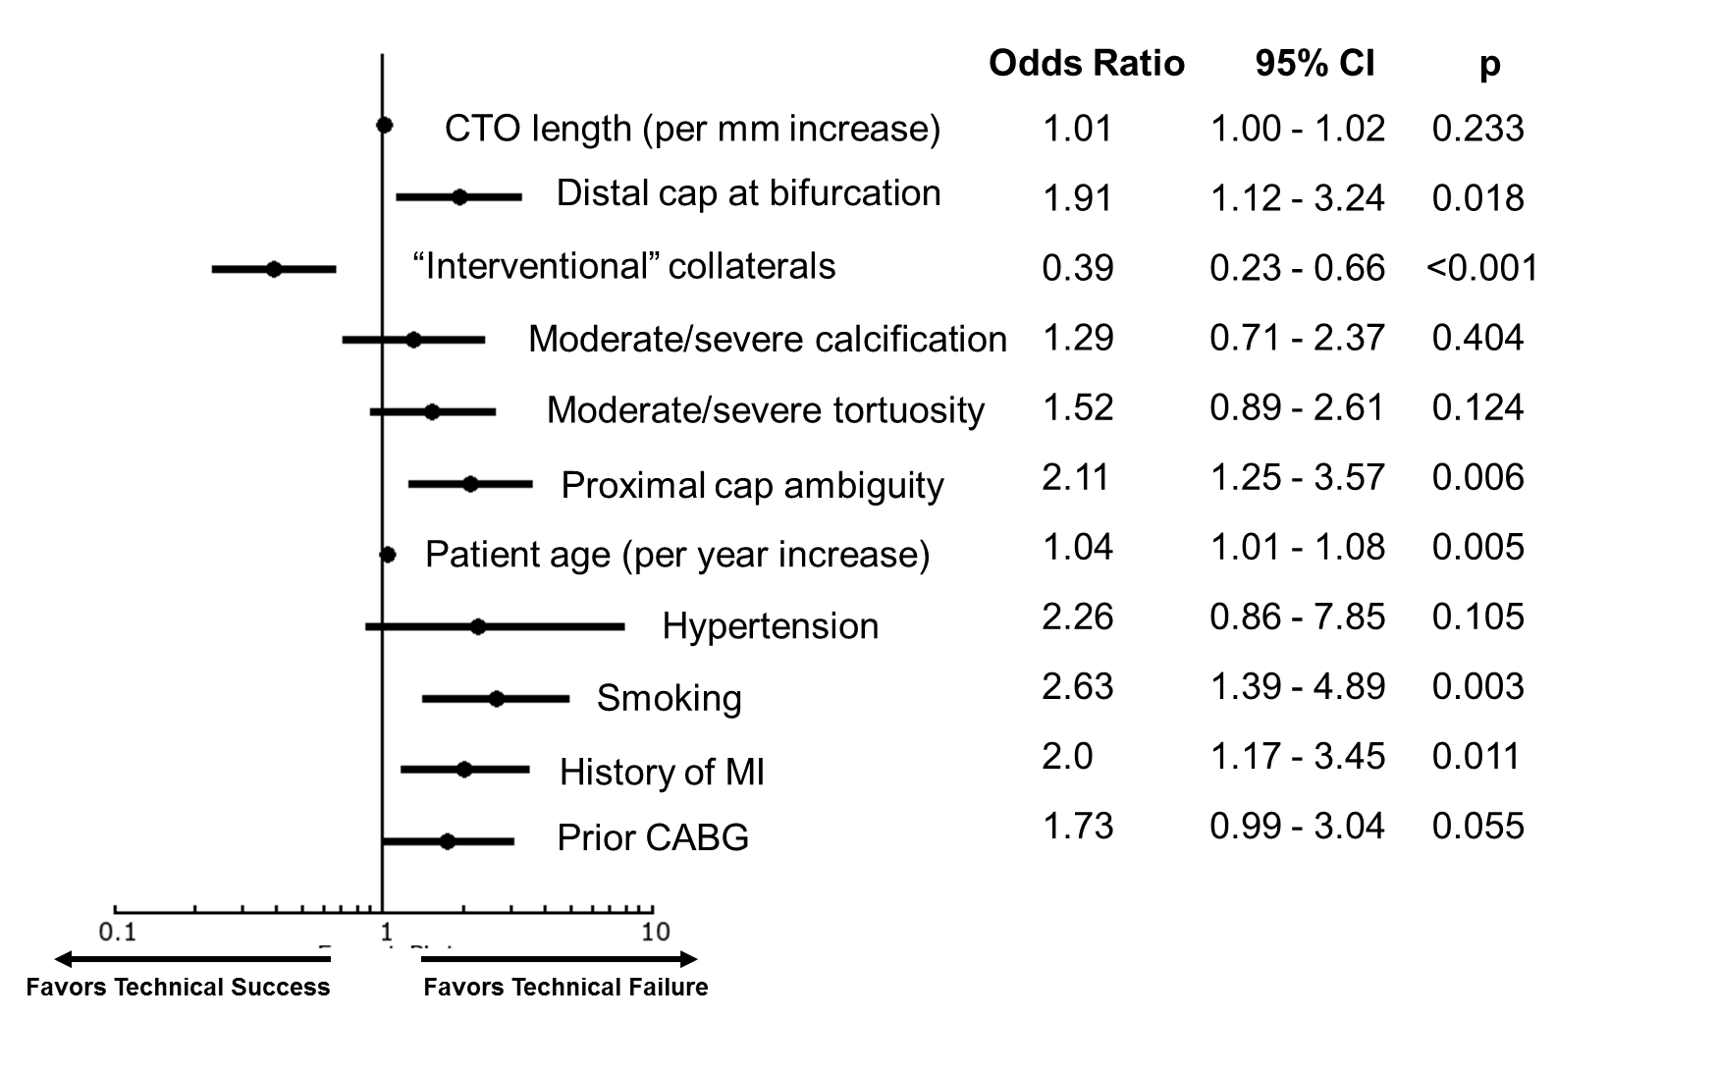
PROspective Global REgiStry for the Study of CTO interventions
Proximal cap ambiguity

Slide 19
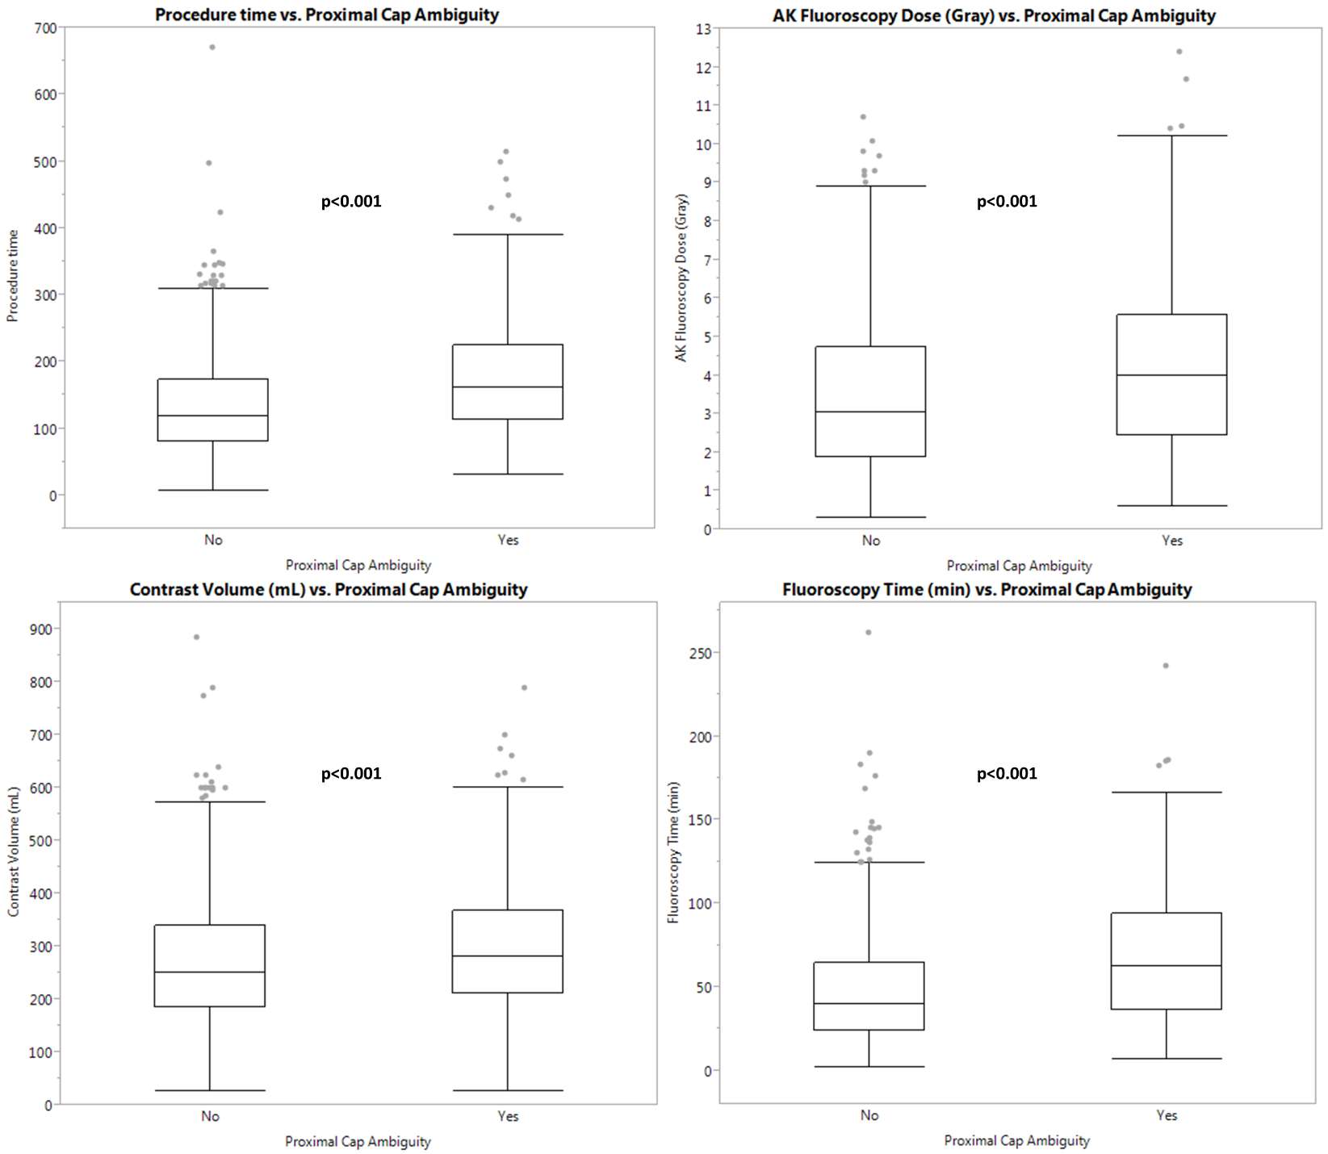
PROspective Global REgiStry for the Study of CTO interventions
Proximal cap ambiguity
Procedure time
Air kerma
p<0.001
p<0.001
Contrast volume
Fluoroscopy time
p<0.001
p<0.001

Slide 20
PROspective Global REgiStry for the Study of CTO interventions
www.progresscto.org
Overall update
PROGRESS CTO score
Prior CTO PCI failure
Proximal cap ambiguity
CTO age
Radiation
Antegrade guidewire utilization
Retrograde Analysis
RCA CTO
Hemodynamic support
Imaging
Bifurcations

Slide 21
Lesion Age
PROspective Global REgiStry for the Study of CTO interventions
N=394
9 US centers
Median lesion age=12 months ; Mean lesion age 43.3 months
1st tertile <5 months, 2nd tertile ≥5 months and <36.3 months, 3rd tertile ≥36.3 months
Danek, Karatasakis, Karmpaliotis, Alaswad, Yeh, Jaffer, Patel, Bahadorani, Lombardi, Wyman, Grantham, Doing, Moses, Kirtane, Parikh, Ali, Kalra, Kandzari, Lembo, Garcia, Nguyen-Trong, Karacsonyi, Alame, Kalsaria, Rangan, Thompson, Banerjee, Brilakis.

Slide 22
Lesion Age
PROspective Global REgiStry for the Study of CTO interventions
Δ=5.2%
p=0.37
N=394
Δ=2.7%
p=0.80
Δ=3.3%
p=0.31
Danek, Karatasakis, Karmpaliotis, Alaswad, Yeh, Jaffer, Patel, Bahadorani, Lombardi, Wyman, Grantham, Doing, Moses, Kirtane, Parikh, Ali, Kalra, Kandzari, Lembo, Garcia, Nguyen-Trong, Karacsonyi, Alame, Kalsaria, Rangan, Thompson, Banerjee, Brilakis.

Slide 23
Lesion Age
PROspective Global REgiStry for the Study of CTO interventions
Successful crossing strategy in 1st tertile lesion age
Successful crossing strategy in 3rd tertile lesion age
N=394
p=0.008
Danek, Karatasakis, Karmpaliotis, Alaswad, Yeh, Jaffer, Patel, Bahadorani, Lombardi, Wyman, Grantham, Doing, Moses, Kirtane, Parikh, Ali, Kalra, Kandzari, Lembo, Garcia, Nguyen-Trong, Karacsonyi, Alame, Kalsaria, Rangan, Thompson, Banerjee, Brilakis.

Slide 24
PROspective Global REgiStry for the Study of CTO interventions
www.progresscto.org
Overall update
PROGRESS CTO score
Prior CTO PCI failure
Proximal cap ambiguity
CTO age
Radiation
Antegrade guidewire utilization
Retrograde Analysis
RCA CTO
Hemodynamic support
Imaging
Bifurcations

Slide 25
Radiation in Progress CTO
2012-2015
9 centers
748 CTO PCI
median AK dose: 3.40 (2.00, 5.40) Gray
AK dose (Gray)
Center

Slide 26
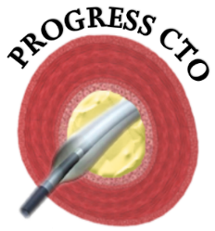
PROspective Global REgiStry for the Study of CTO interventions
Variables associated with AK dose
Variable | Univariable | Multivariable | p-value for univariable | p-value for multivariable
BMI (kg/m²) | 0.10 (0.017) | 0.08 (0.017) | <.0001 | <.0001
Dyslipidemia | 0.668 (0.236) | 0.10 (0.239) | 0.005 | 0.661
Hypertension | 0.335 (0.182) | 0.022 (0.172) | 0.066 | 0.9
Prior PCI | 0.31 (0.11) | 0.138 (0.109) | 0.005 | 0.208
Prior CABG | 0.633 (0.11) | 0.311 (0.110) | <0.001 | 0.005
Prior PVD | 0.267 (0.14) | 0.011 (0.137) | 0.058 | 0.936
Calcification (moderate/severe) | 0.762 (0.105) | 0.293 (0.116) | <.0001 | 0.012
Tortuosity (moderate/severe) | 0.402 (0.115) | 0.032 (0.113) | 0.005 | 0.778
Proximal cap ambiguity | 0.362 (0.126) | -0.250 (0.147) | 0.004 | 0.09
Distal cap at bifurcation | 0.374 (0.117) | 0.222 (0.113) | 0.002 | 0.051
J-CTO score | 0.60 (0.09) | 0.39 (0.12) | <.0001 | 0.001
Blunt stump/ | 1.208 (0.212) | 0.993 (0.247) | <.0001 | <.0001
No stump

Slide 27
PROspective Global REgiStry for the Study of CTO interventions
www.progresscto.org
Overall update
PROGRESS CTO score
Prior CTO PCI failure
Proximal cap ambiguity
CTO age
Radiation
Antegrade guidewire utilization
Retrograde Analysis
RCA CTO
Hemodynamic support
Imaging
Bifurcations

Slide 28
PROspective Global REgiStry for the Study of CTO interventions
Antegrade guidewire utilization
2012-2015
15 centers, 1,011 lesions
Antegrade wire escalation: 694 (69%)
Karatasakis, Tarar, Karmpaliotis, Alaswad, Yeh, Jaffer, Wyman, Lombardi, Grantham, Kandzari, Lembo, Moses, Kirtane, Parikh, Garcia, Doing, Pershad, Shah, Patel, Bahadorani, Shoultz Jr., Danek, Thompson, Banerjee, Brilakis.

Slide 29
PROspective Global REgiStry for the Study of CTO interventions
www.progresscto.org
Overall update
PROGRESS CTO score
Prior CTO PCI failure
Proximal cap ambiguity
CTO age
Radiation
Antegrade guidewire utilization
Retrograde Analysis
RCA CTO
Hemodynamic support
Imaging
Bifurcations

Slide 30
PROspective Global REgiStry for the Study of CTO interventions
Retrograde vs. antegrade-only: outcomes
2012-2015
11 centers, 1,301 lesions
Retrograde utilization: 41%
Δ= 8.9%
P<0.001
Δ=11.4%
P<0.001

Slide 31
PROspective Global REgiStry for the Study of CTO interventions
Retrograde vs. antegrade-only: in-hospital MACE
p<0.001
p=0.003
p=0.039
p=0.167
p=0.999
P=0.314

Slide 32
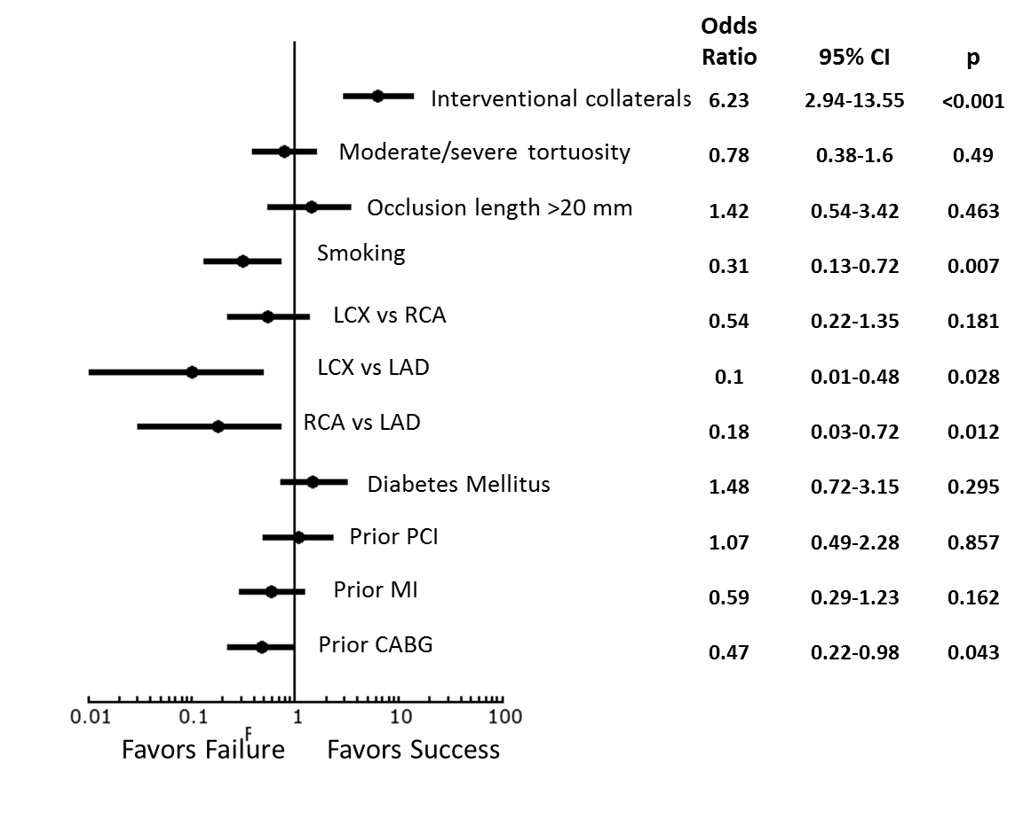
PROspective Global REgiStry for the Study of CTO interventions
Retrograde: predictors of technical success

Slide 33
PROspective Global REgiStry for the Study of CTO interventions
www.progresscto.org
Overall update
PROGRESS CTO score
Prior CTO PCI failure
Proximal cap ambiguity
CTO age
Radiation
Antegrade guidewire utilization
Retrograde Analysis
RCA CTO
Hemodynamic support
Imaging
Bifurcations

Slide 34
PROspective Global REgiStry for the Study of CTO interventions
Approaches to RCA CTOs
2012-2015
11 centers, 1,308 lesions
RCA CTOs: 56%
Technical success for RCA: 90%

Slide 35
PROspective Global REgiStry for the Study of CTO interventions
RCA CTOs: successful strategy according to lesion location
p=0.045
Technical success:
89%
89%
96%
79%
p=0.11

Slide 36
PROspective Global REgiStry for the Study of CTO interventions
www.progresscto.org
Overall update
PROGRESS CTO score
Prior CTO PCI failure
Proximal cap ambiguity
CTO age
Radiation
Antegrade guidewire utilization
Retrograde Analysis
RCA CTO
Hemodynamic support
Imaging
Bifurcations

Slide 37
PROspective Global REgiStry for the Study of CTO interventions
Hemodynamic support
2012-2015
11 centers, 1,061 lesions
Hemodynamic Support: 5.3%
Δ=10.4%
p=0.01
Δ=32.6%
p=0.008
Δ=35.2%
p=0.003
Δ=15%
P<0.001
LVAD vs. no LVAD
Prophylactic vs. emergency LVAD

Slide 38
PROspective Global REgiStry for the Study of CTO interventions
www.progresscto.org
Overall update
PROGRESS CTO score
Prior CTO PCI failure
Proximal cap ambiguity
CTO age
Radiation
Antegrade guidewire utilization
Retrograde Analysis
RCA CTO
Hemodynamic support
Imaging
Bifurcations

Slide 39
PROspective Global REgiStry for the Study of CTO interventions
Intravascular imaging
2012-2015
7 centers, 624 lesions
Intravascular imaging: 38%
Karacsonyi, Alaswad, Jaffer, Yeh, Karmpaliotis,, Patel, Bahadorani , Grantham, Lombardi, Doing, Moses, Kirtane, Parikh, Kandzari, Lembo,, Resendes, Alame, Kalsaria, Rangan, Karatasakis, Danek , Ali, Garcia, Ungi, Thompson, Banerjee, Brilakis

Slide 40
PROspective Global REgiStry for the Study of CTO interventions
www.progresscto.org
Overall update
PROGRESS CTO score
Prior CTO PCI failure
Proximal cap ambiguity
CTO age
Radiation
Antegrade guidewire utilization
Retrograde Analysis
RCA CTO
Hemodynamic support
Imaging
Bifurcations

Slide 41
Side Branch Loss
PROspective Global REgiStry for the Study of CTO interventions
N=109
Side branch loss occurred in 28 cases (25.7%)
Higher cardiovascular mortality (7.4% vs. 0%, log rank p=0.017)
Single center – Dallas VA
Major complications: 1.8% (perforation with pericardiocentesis,
stent thrombosis within 24 hours)
Nguyen-Trong PJ, Rangan BV, Karatasakis A, Danek BA, Christakopoulos GE, Martinez-Parachini JR, Resendes E, Ayers CR, Luna M, Abdullah S, Kumbhani DJ, Addo T, Grodin J, Banerjee S, Brilakis ES.
J Invasive Cardiol. 2016 Jan 15. Epub ahead of print.

Slide 42
PROspective Global REgiStry for the Study of CTO interventions
www.progresscto.org
Solid contemporary outcomes in CTO PCI
Opportunities for improvement
Case selection
Improve safety
Improve efficiency

Slide 43
For more information or to join:
www.progresscto.org

